Slide 1
Retrospective Analysis of Musculioskeletal Complications in Patients with Tuberculosis
Hosseinian Amiri Aref, Abedi Siavash, Yazdanian Maryam

Slide 2
Background: In adults, Osteoarticular involvement with M. tuberculosis, usually occurs from either a quiescent pulmonary focus or an extrapulmonary site. The definitive diagnosis is made by the demonstration of M. tuberculosis in tissue or synovial fluid. Common presentations of osteoarticular tuberculosis are spinal TB, Infection at peripheral joint especially weight-bearing joints, tendons, bursae, or bones and Reactive arthritis (Poncet’s disease).
Aim: The aim of this study was analysis of 10 adult patients with tuberculosis to determine the pattern of musculoskeletal complications during 2 years.

Slide 3
Subjects and Methods: This is a retrospective study of cases of musculoskeletal complications among patients with tuberculosis during two years that refers to rheumatologic clinic of mazandaran university of medical sciences at January 2011 to December 2013. Data were analyzed using the SPSS version 20. Variables analyzed include age, sex and kind of musculoskeletal complications.
Results: There were 10 patients with tuberculosis refers in our rheumatologic clinic for musculoskeletal complications. All of patients were adults between 18 to 48 years old with median age of 30.8 years old. Seven (70%) patients were male and 3(30%) patients were female. The most common musculoskeletal complication was spondylodiscitis in 6 (60%), arthritis in 5 (50%), osteomyelitis in 2 (20%), reactive arthritis in 2 (20%), soft tissue abcess in 2 (20%) and dactilitis in 1 (10%) of patients.

Slide 4
Conclusion: Musculoskeletal complications are very important and must be considered in patients with tuberculosis. Spondylodiscitis (pott’s disease) and arthritis of weight bearing large jonts are the most common rheumatologic complications of this disorder.

Slide 5
KEYWORDS
Musculoskeletal complications,
Spondylodiscitis,
Tuberculosis,
Peripheral arthritis,
Poncet's disease.

Slide 6
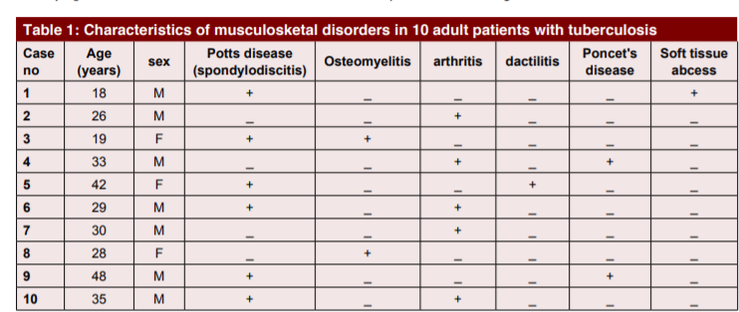

Slide 7
The most common musculoskeletal complications in adults with tuberculosis are insidious onset of spondylodiscitis that commonly occurred in thoracolumbar resion of spine and peripheral joint arthritis that commonly occurred in lower weight bearing joint and especially in knee joint. Other complications including osteomyelitis, dactilitis and reactive arthritis or poncet's disease. In comparison with another studies of adult patients with tuberculosis, the spinal involvement was similar at thoracolumbar region involvement. In other study, the hip join was involved more frequently but at this study knee joint involved more frequently. Other findings were similar to another studies. The small sample size and inability to explore other risk factors also limited this work and its generalizability.

