Slide 1
Efficacy and tolerability of two intravaginal formulations containing clindamycin plus clotrimazole in women with vaginal infections: A pilot study
Daswani Bharti Ramchand, Naik Shilpa, Palewar Meghana, Ghongane Balasaheb, Sambarey Pradeep, Bharadwaj Renu

Slide 2
Aim: To compare the effectiveness and tolerability of soft gelatine capsule versus Extended-release tablet containing clindamycin with clotrimazole in vaginal infections.
Subjects and Methods: Following baseline vaginal examination, 66 women having clinical diagnosis of vaginal infection were randomized to receive three doses [once daily] of an immediate release (SG-group) or an extended release combination of clindamycin with clotrimazole (ER-group) and followed up for assessing resolution of clinical and microbiological evidence of vaginal infection by 8th day; maintenance of clinical and microbiological cure at 29th day; and occurrence of side effects. Results were presented using descriptive statistics. Qualitative data was analyzed by Fischer’s Exact test Unpaired t-test was used for quantitative data.

Slide 3
Results: 27 women from SG-group and 30 women from ER-group completed the study. In SG-group, 69.23% had complete cure and 7.69% had partial remission at 8th day of which 88.89% maintained remission, while in ER-group 73.68% women had a complete cure of which 85.71% maintained remission on 29th day. Delayed remission was observed in 25% women from SG-group and 60% women from ER-group, while none of the women experienced intolerable adverse effects.
Conclusion: Both formulations containing clindamycin plus clotrimazole were effective, as empiric therapy, in inducing and maintaining microbiological as well as clinical remission in women with clinical diagnosis of vaginal infection to a similar extent but should not to be recommended for cases specifically identified to have trichomoniasis. An adequately powered study using a larger population should be conducted to further explore differences between these two formulations.

Slide 4
KEYWORDS
Clindamycin,
Clotrimazole,
Vaginal formulation,
Vaginal infections.

Slide 5
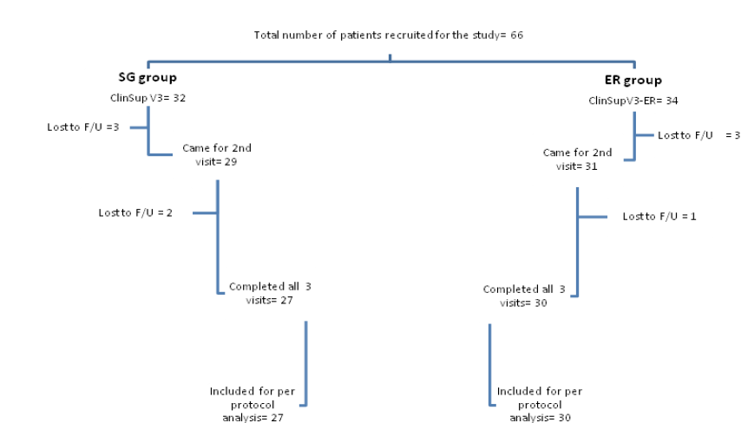
Figure 1: Subject enrollment and follow-up

Slide 6
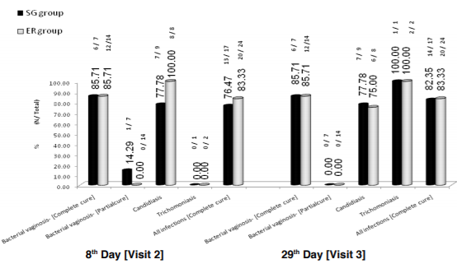
Figure 2: Microbiological cure at second and third visit - percentage of infections.

Slide 7
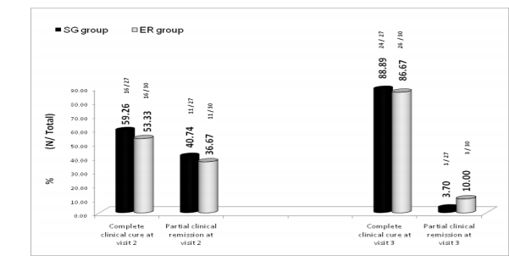
Figure 3: Clinical response at second and third visit- percentage of subjects.

Slide 8
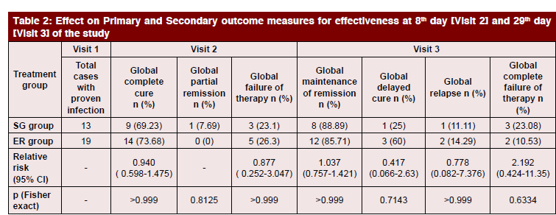

Slide 9
Empirical treatment with both intra-vaginal dosage forms containing clindamycin with clotrimazole produced clinical and microbiological cure as well as maintained remission in substantial number of women with clinical diagnosis of vaginal infection. Amongst individual infections, trichomoniasis showed least response. Neither of the two formulations could treat trichomoniasis by end of first week, though there was a delayed response of similar magnitude with both formulations. Thus, a clinical or microbiological diagnosis of trichomoniasis should essentially prompt systemic treatment of both sexual partners with metronidazole or tinidazole.

Slide 10
Secondly, although this study did not find evidence that the two formulations differed with respect to efficacy or tolerability, in the context of treatment of candidiasis, abnormal vaginal bacterial flora, and abolition of lactobacilli, the magnitude of difference (in terms of percentage) was large enough to be clinically relevant.
Being a pilot study, with a small sample size, it is not possible to draw valid conclusions regarding the differences between clinical and microbiological efficacy of the two formulations. Hence, an adequately powered study using a larger population should be conducted to further explore differences between soft gelatin capsule and extended-release tablet on these parameters.

