Slide 1
Aphrodisiac Activity of Cocos nucifera Attentuates Ceric Sulphate Induced Infertility in Male Rats
Ramakrishnan Prakash, Rajulu Dheeraj, Palayan Muralidharan, Krishnan Karthickeyan, Raji Vijayakumar, Thiraviam Purushoth Prabu

Slide 2
Objective: In the present study, we examined the effect of hydroalcoholic extract of apical bud of cocos nucifera (HACN) in ceric sulphate induced infertility in male rats.
Methods: Rats weighing 180 to 200 gm were randomized into 4 groups of 6 animals each that included saline treated rats (normal) were orally administered once daily with 0.5ml of distilled water, Ceric sulphate treated (1 mm/100 gm., s.c.) and HACN treated (200 and 400 mg/kg., p.o.). Ceric sulphate was given to the rats for 7 days for all the groups except saline treated rats then followed by administration of the HACN extract for 21 days.

Slide 3
Parameters Evaluated: Sexual behavioural parameters including mount and intromission frequency (MF and IF) and mount, intromission and ejaculation latency (ML, IL, EL) as well as post ejaculatory interval (PEI) and body weight (BW) were recorded in male rats one hour after injection of extract by mating with a receptive female (1:1). Biochemical evaluation such as serum and cauda epididymidal testosterone and dihydrotestosterone (DHT) and histopathological analysis of testis were also assessed.

Slide 4
Results: Ceric sulphate treated rats significantly decreased sexual behaviour and also reduced the serum and cauda epidymidal tissue testosterone and DHT when compared to control rats. All these changes were significantly attenuated by ceric sulphate rats (with HACN extract). Ceric sulphate was found to be inducing sterility in male rats which has been confirmed after analyzing all the parameters of the study
Conclusion: From the results it may be concluded that hydroalcoholic extract of cocos nucifera may be used as a good aphrodisiac activity which can promote the fertility rate.

Slide 5
KEYWORDS
Aphrodisiac,
Ceric sulphate,
Cocos nucifera,
Infertility,
Testosterone.

Slide 6
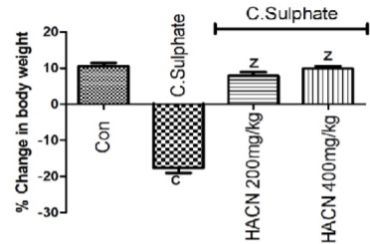
Figure 1: Effect of HACN on Body weight

Slide 7
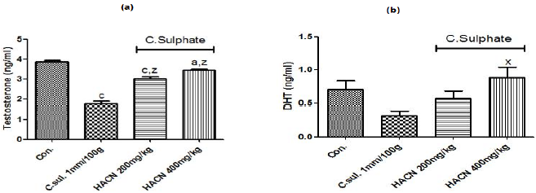
Figure 2 a,b: Effects of HACN treatment on serum testrosterone and DHTconcentrations

Slide 8
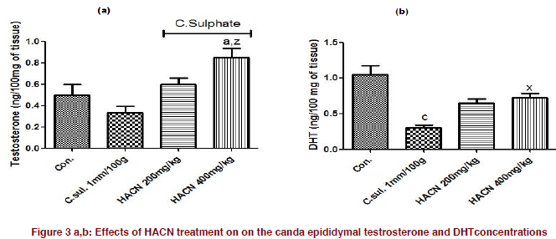
Figure 3 a,b: Effects of HACN treatment on the canda epididymal testrosterone and DHTconcentrations

Slide 9
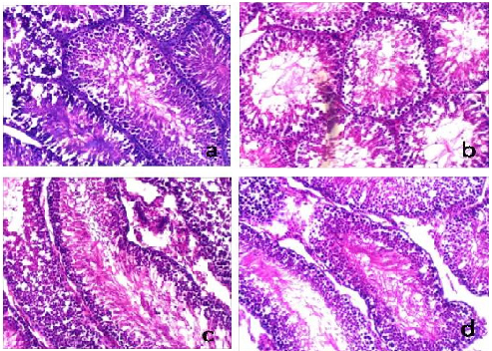
Figure 4: Effects of HACN on histomorphometry on testis

Slide 11
Finally, our present investigation showed that HACN posses facilitatory effects that increase state of sexual desire during sexual interaction with female rats. The aphrodisiac effects of HACN may be due to phytochemical constituents such as steroids, flavonoids, alkaloids, proteins through central and mechanism pathway.

