Slide 1
QSAR Study on Arylthioquinoline Derivatives as Anti-tubercular Agents
Veerasamy Ravichandran, Sivadasan Shalini, Krishnamoorthi Venaktes Kumar, Rajak Harish, Krishnan Suresh Kumar

Slide 2
Aim: The major issue for many anti-tubercular agents is the resistance of Mycobacterium tuberculosis strains. Quinoline compounds serve as anti-mycobacterial agents with encouraging anti-tubercular activity. The main aim of this study is to develop 2D QSAR models for a series of arylthioquinoline to predict their ideal characteristics as potential anti-tubercular agents
Materials and Method: Used CS Chem Office 2004 and Molecular Modeling Pro 6.1.0 software for modeling and models development. Some of the statistical parameters were calculated by using QSARINS (HYPERLINK "http:// www.qsar.it/"www.qsar.it). We have used MLR techniques to develop QSAR models. The developed QSAR models were found to be statistically significant based on internal and external validation parameters.

Slide 3
Results: The significance and predictive ability of the developed QSAR model was confirmed as it satisfied the following conditions: r2=0.817>0.6; CCCtr=0.899>0.85; q2LOO=0.729>0.5; pred_r2=0.922>0.6; pred_r2se=0.186; CCCpred=0.907>0.85; r2m=0.753>0.5; r'2m=0.714>0.5; ∆ r2m=0.039<0.2k'=0.966; k=1.014 (0.85<k or k'<1.15); r2-r2 0/r2=0.064; r2-r'2 0/r2=0.086 (r2-r2 0/r2 or r2- r'2 0/r2<0.1); r2p=0.775>0.5; q2LMO=0.650>0.5. The major outcome of this study is that the density of the molecules significantly influences the anti-tubercular activity of novel arylthioquinoline derivatives.
Conclusion: It can be concluded that the proposed models explained the relationship of the density of arylthioquinolines with their anti-tubercular activity and these can be used as guidance for synthesis of new anti-tubercular agents.

Slide 4
KEYWORDS
Anti-tubercular agents,
3-heteroarylthioquinolinederivatives,
Quantitative structure activity relationship,
Tuberculosis.

Slide 5
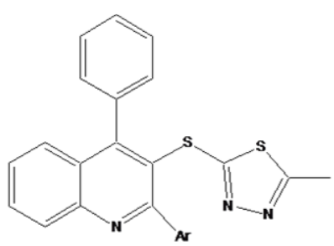

Slide 6
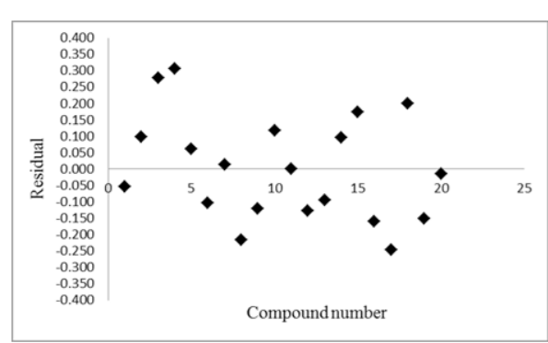
Figure 1: Residual plot between experimental and calculated anti-tubercular activities of both training and test set 3- heteroarylthioquinolines

Slide 7
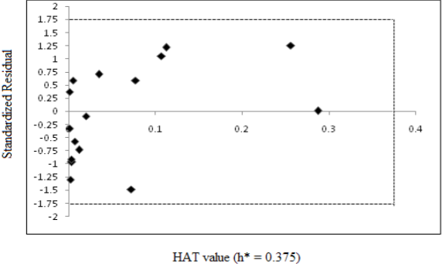
Figure 2: Williams plot: plot of standardized residuals (Y-axis) versus leverages (hat values (X-axis) for each compund

Slide 8
We had developed a QSAR model for a set of twenty3- heteroarylthioquinoline derivatives having Mycobacterium tuberculosis inhibitory activity. The LOO cross-validation methods and Y-randomization technique suggested that the model was significant, robust and possess good internal predictability. The result findings can be utilized in the development and optimization of novel antitubercular agents. The reported QSAR models in the manuscript might be used for predicting the anti- tubercular activity of 3- heteroarylthioquinoline derivatives only. We also suggest to performing 3D QSAR and docking studies to understand the mechanisms of chemical–biological interactions of 3-heteroarylthioquinolines against Mycobacterium tuberculosis.

