Slide 1
Gut Microbiota And Its Role In Drug Metabolism Of Common Drugs - A Short Review
Rohitash Jamwal, Sumanta Kumar Goswami

Slide 2
Our gut is home to over a trillion of microbes existing in a symbiotic relationship with its host organ. The enzymes synthesized by gut Microflora have been long known to influence our health, but their role in the metabolism of drugs has not been studied to that extent. Similar to drug metabolizing enzymes in liver and intestine, gut Microbiota can modulate the metabolism of drugs in a number of ways including but not limited to hydrolysis, reduction, or degradation of a drug molecule. The role of liver and intestine has been extensively studied during early drug discovery for its influence on drug metabolism but very less emphasis is given to metabolism of drugs by gut Microbiota. This review paper discusses the role of gut Microflora and its role to alter drug metabolism and advocate the inclusion of microbial metabolism screening during drug development.

Slide 3
KEYWORDS
Digoxin,
Drug Metabolism,
Gut Microbiota,
Phenacetin,
Sorivudine.

Slide 4
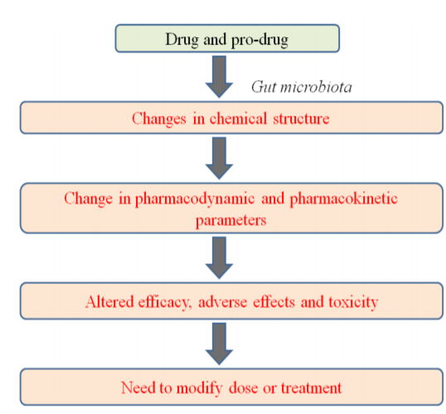

Slide 5
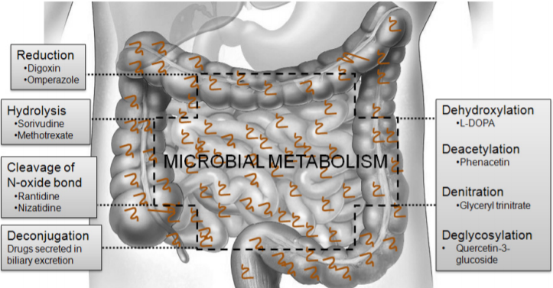
Figure 1: Key microbial metabolism reactions of drugs and major drugs which are undergo microbial metabolism in the GI tract

Slide 6
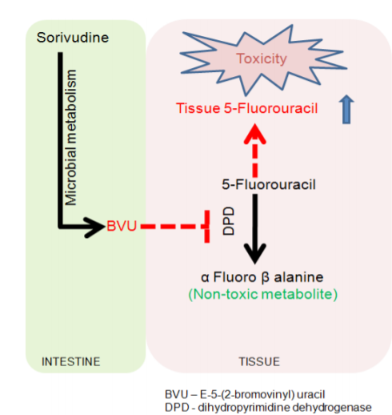
Figure 2: Hydrolysis of Sorivudine to BVU by gut Microflora

Slide 7
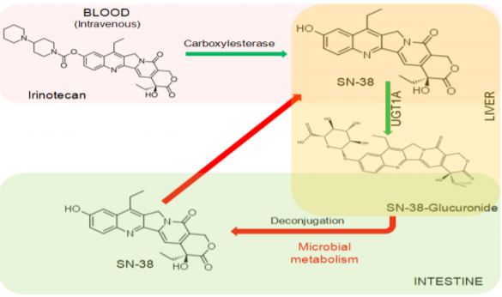
Figure 3: Deconjugation of SN-38 glucuronide to parent drug by microbial metabolism

Slide 8
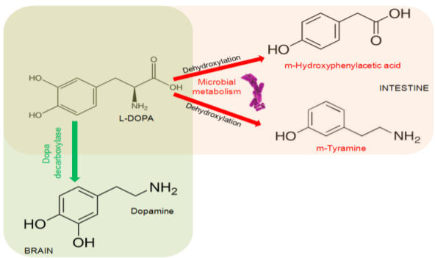
Figure 4: Dehydroxylation of L-DOPA to m-Tyramine and/or m-Hydroxyphenylacetic acid by microbes in the gut

Slide 9
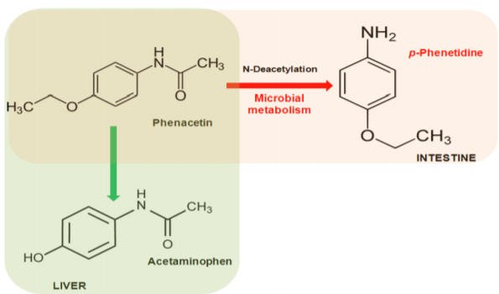
Figure 5: Deacetylation of Phenacetin to p-Phenetidine by gut microbes

Slide 10
An understanding of the implications of microbial metabolism is expected to increase with time as more and more drugs are being identified as substrates for gut Microflora. As discussed in this short review, a large number of drugs already in the market are substrates for microbial metabolism, and this highlights the importance of including microbial metabolism of the drug during the development phase.

