Slide 1
Menstrual Discomforts and the Treatment Preferred by University Students
Sivadasan Shalinia, Sundar Hemalathaa, Wong Chui Tinga, ManiamYoshitaa, Balasubramanian Ganesh Pandiana, Abdul Nazer Alia, Kasi Marimuthub, Veerasamy Ravichandrana

Slide 2
Background: Menstrual disorders are one of the major problems faced by women all around the world and may have considerable psychological and physical consequences in student community and contribute to absenteeism.
Objective: This study was conducted to investigate student’s experience of and their response to menstrual symptoms and also to understand the impact of the respondents’ study background on the treatment preferred for the menstrual discomforts.
Methods: The survey was carried out using a pre-validated questionnaire consisting 29 questions, organized into two sections viz., the first section includes 10 items on the demographic details; second section includes 19 questions related to menstrual problems and the treatment preferred.

Slide 3
Results: A total of 592 questionnaires were returned by the participants giving a response rate of 70% and only 569 questionnaires were completely filled. Among the participants, 34.97% of students responded to have irregular menstrual cycle. The participants responded that menstrual discomforts was a reason for them to avoid physical exercise (64.0%), feel depressed (54.8%), absent from classes (20.0%) and also that it affected work ability (44.1%), academic activities (32.3%), social relationship (30.2%).
Conclusion: In this study, the most common discomfort experienced by the students was pain cramps leading to usage of pain killers as their main choice. Among alternative medicines, Chinese medicine was their most preferred choice of treatment, whereas in home remedies, raw ginger was their choice. An educational intervention regarding menstrual problems and the importance to seek medical advice can help these students to be concerned on their health.

Slide 4
KEYWORDS
Alternative medicines,
Home remedies,
Menstrual discomforts,
Preferred,
Students,
Treatment.

Slide 5
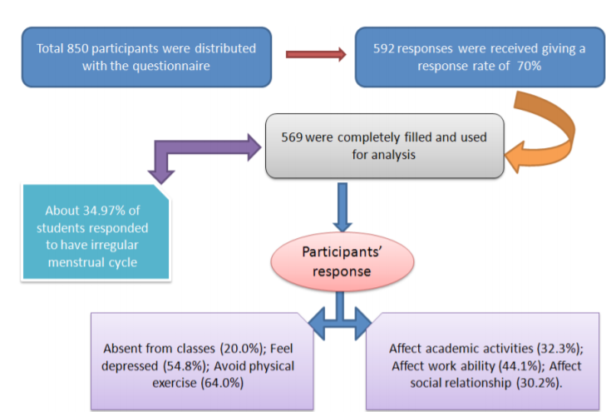

Slide 6
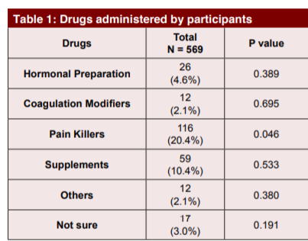

Slide 7
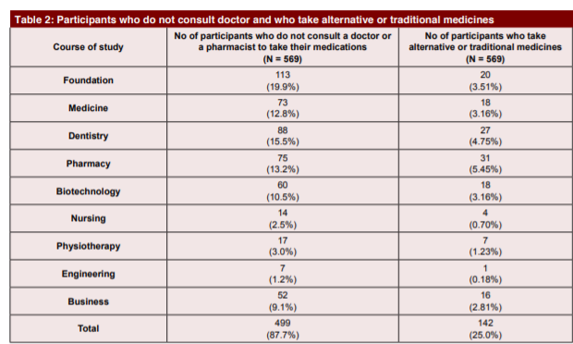

Slide 9
Menstrual disorders are very common in adolescents especially among university students due to many factors that may contribute to the irregularity of menstrual disorder. In the present study, the most common discomfort experienced by these students was pain cramps during menstruation followed by anger and loss of appetite. Other symptoms including feeling depressed and affecting their work ability were also experienced by them. The preferred choice for the treatment of the menstrual discomfort by these students was pain killer followed by supplements and hormonal preparation. In alternative medicine, Chinese medicine was the most preferred choice of treatment. Home remedies such as raw ginger, aloe vera and fenugreek were also their choice of treatment among alternative medicine. About more than a quarter of percentage of the participants chose the reason for not seeking medical attention as it was not necessary.

Slide 10
Students from health care professionals like medicine, physiotherapy, nursing, dentistry, pharmacy were in the opinion of not to seek medical advice. This might be due to their knowledge gained on health during their study, which should not be encouraged. However the treatment option in the future by engineering, dental, pharmacy and biotechnology students was dietary supplement as their first choice, whereas foundation, medicine and business students chose yoga and meditation and the rest chose home remedies. In summary, these participants failed to seek medical advice to address their menstrual problem. They have to consider this problem as their health issue. A health education program regarding menstrual problems would help these students to be concerned on their health.

