Slide 1
Antihypergluco-lipidemic and Antioxidant activities in Aqueous methanol Extract of Some Vegetables Peel: An in vitro Analysis
Srishti Shuklaa, Ambati Anushaa, Katta Archanaa, Dommati Anand Kumara, Amtul Zehraa,Yellu Narsimha Reddy, Ashok Kumar Tiwaria

Slide 2
Objective: To examine phytochemical constituents, antihyperglycemic, antihyperlipidemic and free radical scavenging activities in 50% methanol extract of peels of Cucumis melo var. chito (CM), Cucumis pubescens (CP), Lagenaria siceraria (LS), Luffa acutangula (LA), and Momordica charantia (MC) applying in vitro methods.
Materials and Methods: Total polyphenol (gallic acid equivalent; GAE), flavonoid (rutin equivalent; RE) and anthocyanin (cyanidine-3-glucoside equivalent; CGE) content were estimated. The 2,2-diphenyl-1-picrylhydrazyl (DPPH); 2,2-azinobis(3-ethylbenzthiazoline6-sulphonic acid) (ABTS.+); nitric oxide (NO) scavenging; nitro blue tetrazolium (NBT) reduction; advanced glycation end-products (AGEs), intestinal α-glucosidase, pancreatic lipase and liver Protein-tyrosine phosphatase 1β (PTP 1β) inhibitory activities were examined in vitro.

Slide 3
Results: Peel of CM (1190 μgGAE/g) and MC (923 μgGAE/g) was rich in polyphenol and flavonoids (68.8, 145.1 μgRE/g respectively). Anthocyanin content was more in MC (167 mg CGE/100 g) than others. LS potently scavenged ABTS.+ (SC50, 99 μg) and DPPH (SC50 , 0.6 mg) radicals. Inhibition of vesperlysine like AGEs (71.5%) was significant (p<0.006) than pentosidine-like AGEs (14.8%) by LA peel. Inhibition of pentosidine-like AGEs was significant (p<0.009) by CM than CP peel. MC reduced (84.5 %) only vesperlysine-like AGEs. Intestinal α-glucosidase was inhibited (23.02 %) by MC peel only. Pancreatic lipase was inhibited by CM (74.5%) and CP (58.6 %) peels. The LS reduced PTP 1β (32.1 %) more potently than others.
Conclusion: Vegetable peels present variable degree of antioxidant, antihyperglycemic and antihyperlipidemic activities.

Slide 4
KEYWORDS
Advanced glycation end products,
Antioxidant,
Intestinal α-glucosidase,
Porcine pancreatic lipase,
Protein-tyrosine phosphatase 1β.

Slide 5
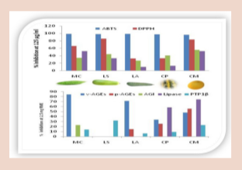

Slide 6
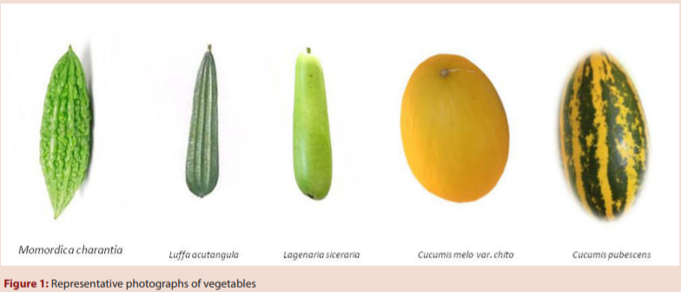

Slide 7
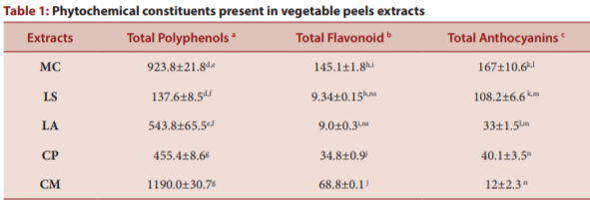

Slide 8
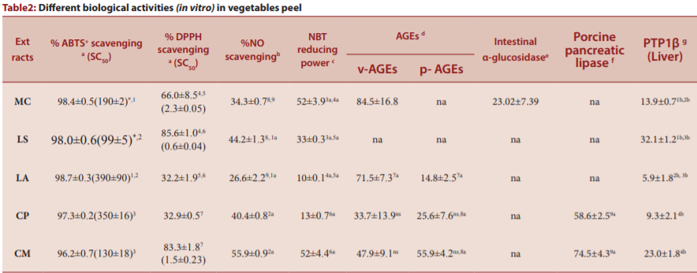

Slide 9
Peels of vegetables were found to be rich source of polyphenols, flavonoids and anthocyanins. The aqueous methanol extract of vegetable peels reported in this study, displayed multifaceted free radicals scavenging and antioxidant potentials. Peels of MC, LA, CP and CM displayed varying but potent AGEs inhibitory activity. This property may help attenuate disorders related with metabolism, oxidative stress and ageing. Furthermore, presence of intestinal α-glucosidase inhibitory activity in MC, and pancreatic lipase inhibitory activity in CP and CM may become helpful in reducing postprandial hyperglycemic and hyperlipidemic burden induced by carbohydrate and lipid rich diet respectively. Interestingly, the presence of PTP1β inhibitory activity in vegetable peels and its association with free radical scavenging properties, presents exciting opportunity for their incorporation in diet, for they can attenuate development of oxidative stress together with insulin resistance and leptin resistance.

