Slide 1
Synthesis and characterization of PEGylated guar gum based nanoparticles: New approach in novel drug delivery system
Venugopal Vijayan, Munuswamy Purushothaman, James Anbu Raj

Slide 2
Objective: To investigate the synthesis of guar gum PEGylation and the nanoparticles preparation and evaluation of drug release characters were studied.
Methods: The PEGylated particle was prepared by emulsification with cold homogenization.
Results: The Acyclovir loaded nanoparticles were uniform and spherical with smooth surface. The entrapment efficiency (EE %) was in range of 60-95%. The entrapment was increased with increase in concentration of PEGylated guar gum. The particle size of Acyclovir nanoparticle was in range between 234.8-879.6 nm with polydespersibility range of 0.006-0.024, which reveals monodisperse nature.

Slide 3
The PEGylated nanoparticle showed sustained drug release at 24 hours in the range of 54.28-62.58%. The drug release behaviour was reported by zero order release with diffusion and erosion mechanism.
Conclusion: The PEGylation was done successfully with guar gum. These PEGylated guar gum was produced spherical shaped nanoparticles and it was circulating and sustained the drug release in biocompatible manner. Acyclovir PEGylated nanoparticle was best choice for prolonged the drug release in HIV treatment.

Slide 4
KEYWORDS
Acyclovir,
Entrapment Efficiency,
PeGlyation,
In vitro Release,
Guar Gum.

Slide 5
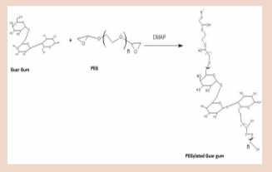

Slide 6
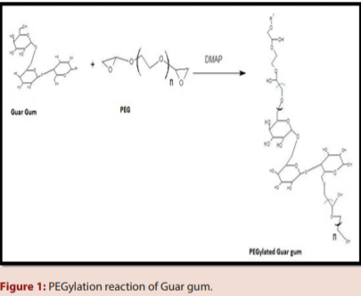

Slide 7
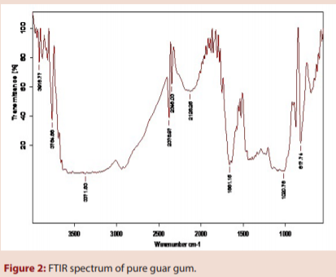

Slide 8
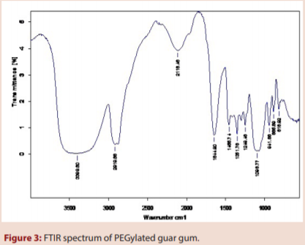

Slide 9
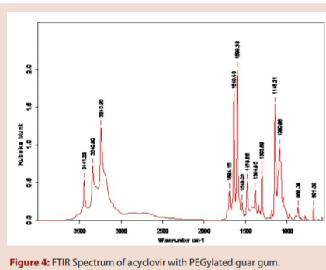

Slide 10
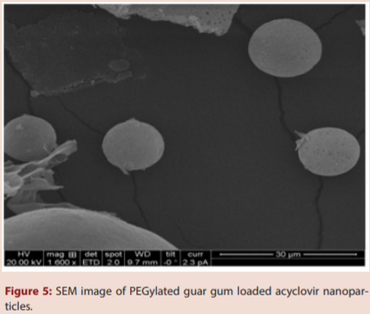

Slide 11
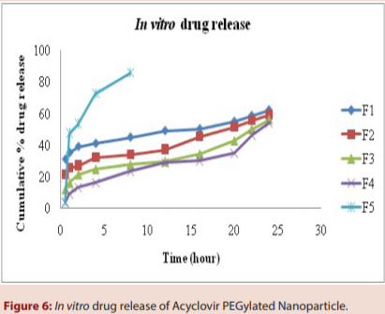

Slide 12
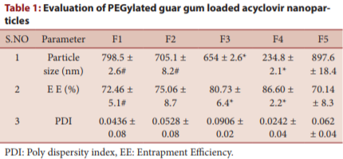

Slide 13
Guargum was PEGylated by using polyethylene glycol 400 with dimethyl amino pyridine. The PEGylation of guar gum was confirmed by FTIR spectrum. The OH group of guar gum was bonded with PEG by ether linkage. The PEGylated guar gum was used for preparing acyclovir nanoparticles. The nanoparticles were prepared by cold homogenization technique with glutaraldehyde as cross linker. The prepared nanoparticles were spherical shape and particle size range of 234.8-879.6 nm with monodisperse nature. The nanoparticles loaded acyclovir showed good entrapment efficiency. The PEGylated nanoparticles loaded acyclovir showed sustained drug release for more than 24 h. the acyclovir loaded nanoparticles were significantly suitable for treating viral infection, due to nontoxic circulation of carriers in biological system.

