Slide 1
Newly Developed and Validated Method of Montelukast Sodium Estimation in Tablet Dosage Form by Ultraviolet Spectroscopy and Reverse Phase-High Performance Liquid Chromatography
Selvadurai Muralidharan, Low Jia Qi, Lai Ting Yi, Narvinder Kaur, Subramani Parasuraman, Jayaraja kumar, Vijayan Venugopal, Palanimuthu Vasanth Raj

Slide 2
Objective: Simple high performance liquid chromatographic (HPLC) and ultraviolet (UV) methods were newly developed and validated for the quantitative estimation of Montelukast (ML) in pharmaceutical dosage form.
Material and Methods: HPLC was carried out by reverse phase-HPLC technique on a C18 column with a good mobile phase consist of 10 mM ammonium acetate and acetonitrile [(pH 5.5 adjusted with orthophosphoric acid (25:75, v/v)]. UV method was developed with the wavelength at 280 nm. Two methods showed good linearity, reproducibility and precision. Both the methods (UV and HPLC) showed no spectral or chromatographic interferences from the tablet excipients.

Slide 3
Results: The developed methods were successfully applied to dosage forms. Validation parameters were carried out such as linearity, precision, accuracy, and specificity. The HPLC LOD and LOQ for montelukast were found to be 150 ng/ml and 500 ng/ml. The UV LOD and LOQ for montelukast were found to be 1 µg/ml and 5 µg/ ml. Both the results were statistically differentiated using one-way analysis of variance (ANOVA). The developed and validated economical methods could be applicable for analysis of ML and monitoring of the quality of available drugs.

Slide 4
KEYWORDS
HPLC,
UV,
Montelukast,
Estimation,
Validation,
Tablets.

Slide 5
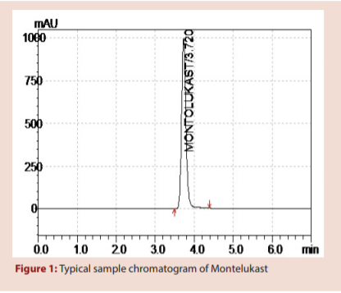

Slide 6
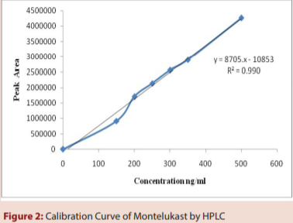

Slide 7
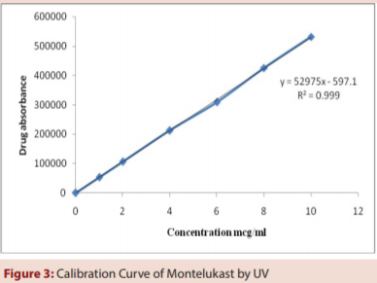

Slide 11
A validated isocratic HPLC and UV methods have been developed for the determination of ML in dosage forms. The proposed methods are simple, rapid, accurate, precise and specific. Its chromatographic run time of 6.0 min allows the analysis of a large number of samples in a short period of time. Therefore, it is suitable for the routine analysis of ML in pharmaceutical dosage forms. The simplicity of the method allows for application in laboratories that lack sophisticated analytical instruments such as LC–MS/MS or GC–MS/MS that are complicated, costly and time consuming rather than a simple HPLC–UV method. Considering the possible worldwide development of counterfeit Mukonil, the proposed method could be useful for the national quality control laboratories in developing countries.

