Slide 1
Evaluation of Metabolic Syndrome Signs in two Different Animal Models
Ashutosh Chaturvedi, Basavaiah Ravishankar, Niranjan Rao, Ravi Mudugaru

Slide 2
Objective: In experimental pharmacology fructose induced metabolic syndrome is one among the standardized model used to induce insulin resistance across the globe. Various laboratory guidelines define different methods for the same. Hence the study has been undertaken to standardized and compare between two rat models of metabolic syndrome based on biochemical and histopathological examinations after permission was obtained from the institutional ethical committee.
Methods: In experimental study wistar albino rats were subjected to evaluate the influence of fructose by two different methods to induce metabolic syndrome. Analysis of data was done with one way ANOVA followed by Dunnet’s multiple comparison T test with Post hoc test using “Graphpad prism Instat software”.

Slide 3
Results: Induction of metabolic syndrome was done in current study with using 15 % of fructose in group 1 took 8 weeks with P value 0.0456, considered signify t=2.427 with 7 degrees of freedom, however group 2 which was induced by high diet 60% fructose in less duration of only 2 weeks with two tailed P value is < 0.0001, considered significant. Changes were higher in Diet induced metabolic syndrome.
Conclusion: Both models have shown elevated blood glucose level, fructose diet group has shown higher glucose level in comparison to fructose drinking water group. The elevated glucose level may be because of fructose doesn’t stimulate the secretion of insulin from pancreas β cells and also in hypertriglyceridemia there is a reduction in insulin sensitivity this may leads to the formation of hyperglycemia.

Slide 4
KEYWORDS
Metabolic syndrome,
Fructose Diet,
Fructose water,
Insulin resistance,
Insulin sensitivity.

Slide 5
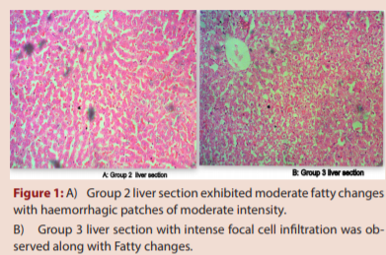

Slide 6
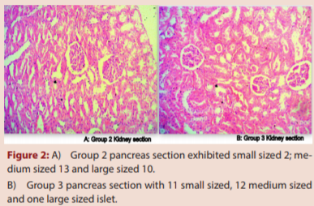

Slide 7
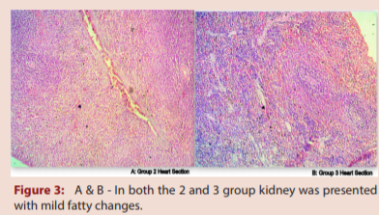

Slide 8
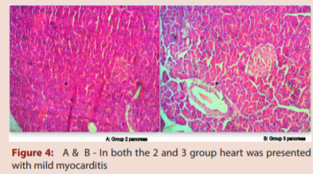

Slide 11
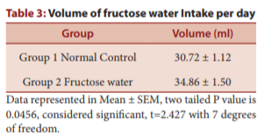

Slide 12
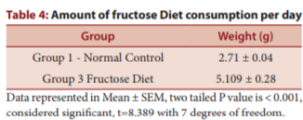

Slide 13
Induction of metabolic syndrome was done in current study with using 15 % of fructose in group 2 took 8 weeks P value is 0.0456, considered signify t=2.427 with 7 degrees of freedom, however group 3 which was induced by high diet 60% fructose in less duration of only 2 weeks with two tailed P value is < 0.001, considered significant. Changes were higher in Diet induced metabolic syndrome.

