Slide 1
Hot-melt extrusion (HME)and its application for pharmacokinetic improvement of poorly water soluble drugs
Devendra Ridhurkar, Attila Vajdai, Zsolt Zsigmond

Slide 2
For orally administered drugs solubility is one of the rate-limiting parameter to achieve their desired concentration in systemic circulation for pharmacological response. Poor solubility and poor permeability is responsible for 40 to 70% incidence of delay or failure for new chemical entities during the developmental process. Due to this, formulation scientist faces a major challenge to develope a formulation with good bioavailability. By adopting various technological approaches during the pharmaceutical product development which include physical and chemical approaches such as micronization, pH adjustment, solid dispersion, complexation, co-solvent, salt formation, nanotechnology, use of surfactant, hydrotophy and polymorphs that can be overcome.

Slide 3
At present due to its wide applications, simple process and low costs, solid dispersion prepared by hot melt extrusion (HME) has gained popularity in the pharmaceutical industry as a means of improving the bioavailability of drugs. Hot-melt extrusion (HME) is an efficient technology for producing solid molecular dispersions with considerable advantages including the absence of solvents, few processing steps, continuous operation over solvent-based processes such as spray drying and co-precipitation and HME is one of the recommended process by FDA to encourage move from batch-to-continuous manufacturing.

Slide 4
KEYWORDS
Hot melt extrusion,
Solid dispersion,
Solubility,
Bioavailability,
Poorly soluble drugs,
Absorption.

Slide 5
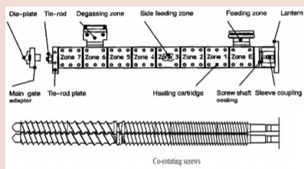
Figure 1: Schematic diagram of an Extruder.

Slide 6
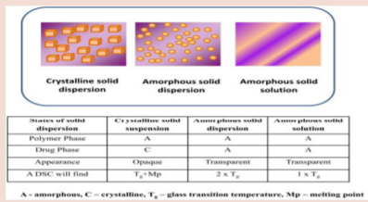
Figure 2: Types of solid dispersion.

Slide 7
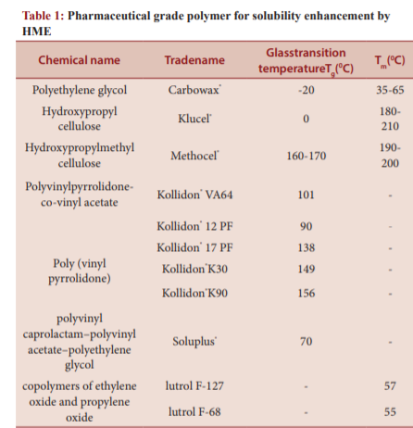

Slide 8
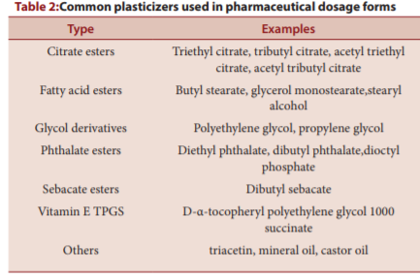

Slide 9
In this study the questionnaire based cross-sectional survey was conducted on the 150 private practioners to assess the status of the KAP regarding spontaneous ADR reporting. The data obtained from the questionnaire quite favor the need of such programmes and schemes that promote and motivate the ADR reporting specially as per participation from private practioners concern. This study contributes to lowering the risks of ADRs the might occurs during the post marketing drug/formulation as well as for the already existed drug/formulation via promoting the ADR reporting from the physician’s side because they might become a potential source for the early signal detection to confirm the minor/major ADR. Other studies have also revealed that ADR under-reporting by health professionals is commonly attributed to reasons such as ADR is not serious, ADR is well known, uncertainty about causal relationship and lack of time etc.37 In agreement with these studies, our study also demonstrated lack of sufficient knowledge among the private practitioners with regards to the type of ADRs to be reported and the purpose of ADR reporting system. Furthermore taking into consideration that government must have to constitute special agencies that not only promote or motivate ADR reporting but also take part in active/passive surveillance to monitor the reporting contribution from different healthcare professionals who directly or indirectly indulge in health care system.

