Slide 1
Simple and Effective HPLC Method Development and its Validation for Ursolic acid in Drug Free plasma: Application to bioanalytical studies
Selvadurai Muralidharan, Jayaraja kumar, Venugopal Vijayan

Slide 2
Objective: Simple and effective high performance liquid chromatographic (HPLC) method was developed for estimation of ursolic acid in drug free human drug free blank plasma.
Material and Methods: The current method was used protein precipitating extraction of ursolic acid from blank plasma. Separation was achieved on reversed-phase C18 column (250×4.6 mm, 5μ) and the detection was monitored by UV detector at 220 nm. The optimized mobile phase was used acetonitrile: 0.5% triethyl amine (pH 4.0), in the ratio of 70:30 % v/v at a flow rate of 1.0 mL/min. This linearity was achieved in this method range of 25.0–150.0 ng/ml with regression coefficient range is 0.99.

Slide 3
Results: The present method is suitable in terms of precise, accurate and specific during the study. The simplicity of the method allows for application in laboratories that lack sophisticated analytical instruments such as GC–MS/MS or LC–MS/MS that are costly, time consuming and complicated rather than a simple HPLC–UV method. The present method was successfully applied for bioanalytical studies.

Slide 4
KEYWORDS
Bioanalytical studies,
HPLC,
Ursolic acid,
Method Development and Validation.

Slide 5
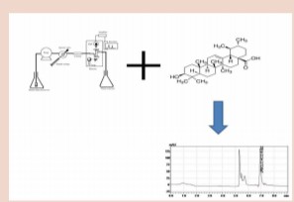

Slide 6
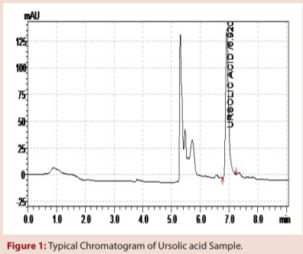

Slide 7
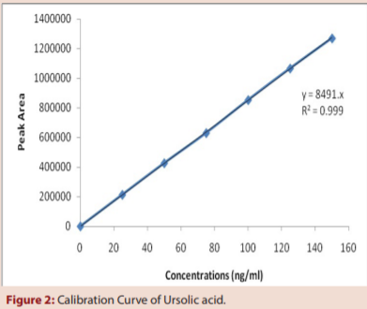

Slide 8
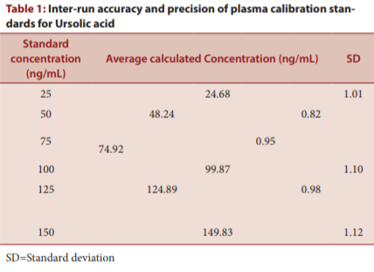

Slide 9
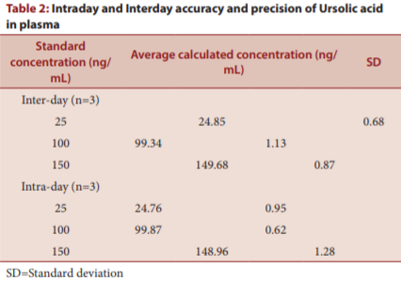

Slide 10
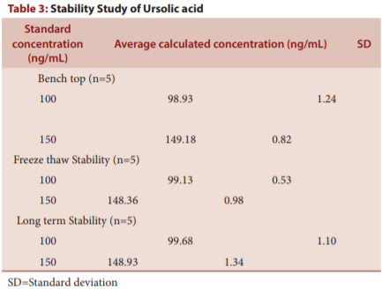

Slide 11
A simple and sensitive method for the determination of ursolic acid in plasma by HPLC was developed and validated. Adequate specificity, precision and accuracy of the proposed method were demonstrated over the concentration range of 25.0-150.0 ng/mL. The method was accurate, reproducible, specific and applicable to the evaluation of pharmacokinetic profiles of ursolic acid and suitable for the bioanalytical study of Ursolic acid.

