Slide 1
Elucidation of In-vitro thrombolytic, membrane stabilizing, cytotoxic activities and phytochemical nature of Bruguiera cylindrica leaves
Safiqul Islam, Md. Shalahuddin Millat, Md. Saddam Hussain, Md. Abdur Rahman, Md. Mizanur Rahman Moghal, Jasmin Ara Nipa, Imam Hasan, Meer Hossain

Slide 2
Objective: The present study was intended to investigate possible phytochemical nature (group determinant of plant extract) and to reveal in-vitro thrombolytic, membrane stabilizing and cytotoxic activities of crude methanolic extracts of Bruguiera cylindrica leaves.
Methods: Collected plant parts were cleaned, dried, and ground to obtain powdery mass. Various methanolic extracts of B. cylindrica was subjected for evaluating membrane stabilizing potentials at a hypotonic solution and heat induce condition, where thrombolytic activity assessment was done by employing Streptokinase as standard. Finally, Cytotoxicity activity was determined by Brine shrimp Lethality bioassay.

Slide 3
Results: Phytochemical screening of methanolic extracts revealed the presence of carbohydrate(s), glycoside(s), phenol, tannin, protein(s), gum and mucilages. Crude methanolic extracts with different doses were used for in-vitro thrombolytic study and 10 mg/ml concentration of plant extracts showed moderate clot lysis (14.51±1.87%) while the standard (streptokinase) showed 59.73 ±0.97% clot lysis. The methanolic extracts exhibited significant anti-inflammatory properties at 10mg/ml concentration by both hypotonic solution and heat induced haemolysis of erythrocyte membrane i.e. 18.53±0.91% and 23.60±0.89% respectively. In contrast to vincristine sulphate the crude methanolic extracts showed moderate cytotoxic properties with LC⁵⁰ value of 16.628. .
Conclusion: Our present study suggest that, further studies may carry on this plant extracts to build up an acceptable report in the medical science.

Slide 4
KEYWORDS
B. cylindrica,
Phytochemical screening,
Thrombolytic,
Membrane stabilizing,
Cytotoxic.

Slide 5
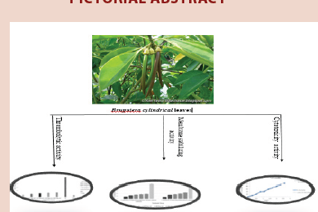

Slide 6
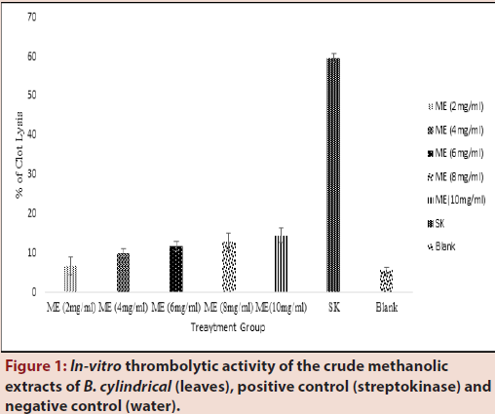

Slide 7
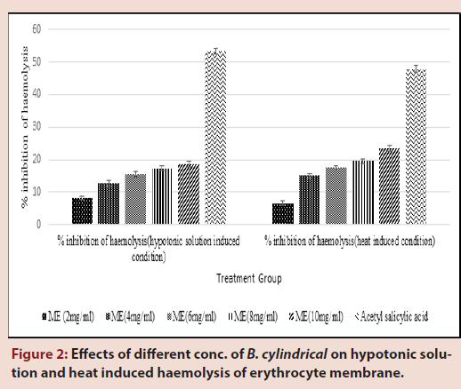

Slide 8
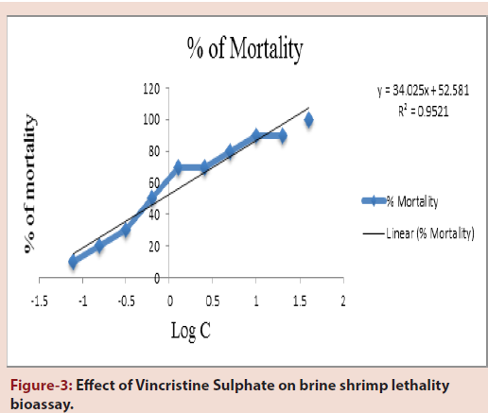

Slide 9
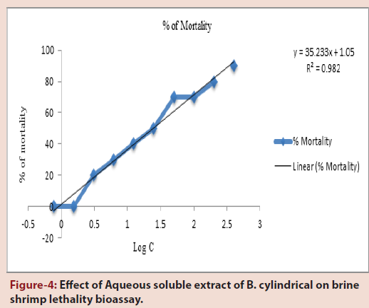

Slide 10
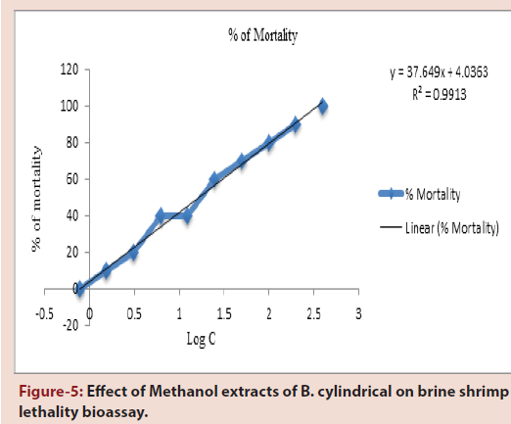

Slide 11
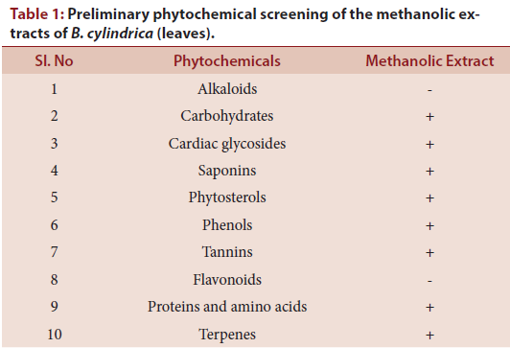

Slide 12
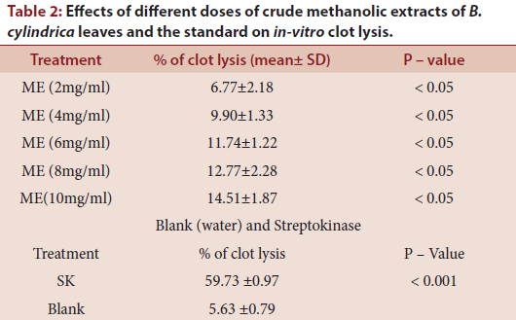

Slide 13
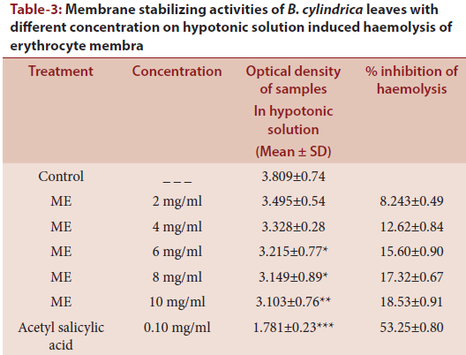

Slide 14
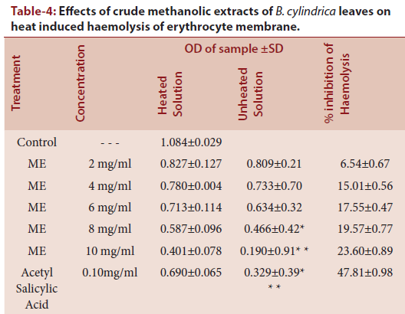

Slide 15
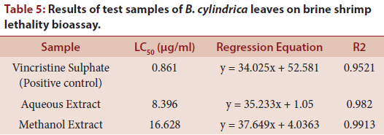

Slide 16
The findings of the present study provide convincing evidence that methanolic extract of B. cylindrica possesses remarkable thrombolytic, membrane stabilizing and cytotoxic activity, with a demands of further biochemical studies for isolating the bioactive compounds and determine the precise mechanisms responsible for the noticed biological activities of this plant.

