Slide 1
Isolation of beta-Asarone from Acorus calamus Linn. and Evaluation of its Anticonvulsant Activity using MES and PTZ Models in Mice
Rahul Kaushik, Jainendra Jain, Rashmi Yadav, Lubhan Singh, Deepika Gupta, Akanksha Gupta

Slide 2
Introduction: Acorus calamus is being used in Ayurveda as Medhya Rasayana to enhance mental ability and used in treatment of various brain related disorders.
Objective: Extraction of volatile oil from Acorus calamus rhizomes and Isolation of β–Asarone from it and anticonvulsant activity of volatile oil in mice using MES and PTZ models.
Method: The volatile (calamus) oil was extracted using hydro steam distillation. Calamus oil was subjected to column chromatography using Silica gel in glass column for isolation of β-Asarone. Calamus oil was evaluated for anticonvulsant activity at 30, 100 and 300mg/kg dose using MES, scPTZ, minimum clonic seizure (at 6 Hz.) model and Rotarod test was used to determine the neurotoxicity of volatile oil.

Slide 3
Results: β-Asarone was isolated and confirmed by structure elucidation using 1 H-NMR, 13C-NMR, IRS, UVS and Mass spectroscopy. Calamus oil was found to be inactive in preliminary screening at all dose levels but has shown neurotoxicity at 300 mg/kg. Although, volatile oil was found to be active in minimal clonic seizure test at 6 Hz. At 100 mg/kg, it displayed protection even up to 4.0hr indicating longer duration of action. ED50 (48.13 mg/kg) and TD50 (224.13 mg/kg) of volatile oil at 6 Hz in mice also determined at 95% C.I. Protective index (PI) value of volatile oil was found to be 4.65. The experimental results were compared with the standard drug Phenytoin (30 mg/kg).
Conclusion: The calamus oil has shown a protective index that can be compared with Phenytoin and can be used as an alternate of synthetic antiepileptic drugs.

Slide 4
KEYWORDS
Anticonvulsant,
Acorus calamus,
β-Asarone,
Calamus Oil.

Slide 5
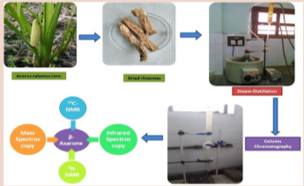

Slide 7
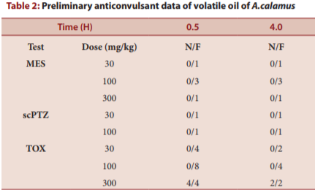

Slide 8
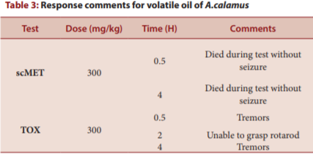

Slide 10
The present study showed various positive approaches for the treatment, long term management and prevention of epileptic seizures. Volatile oil from the rhizomes of Acorus calamus showed a better protective index of 4.65 as compared to standard drugs. The magical drug need to be explored more to increase its therapeutic potential minimizing the associated side effects.

