Slide 1
Ameliorative Effect of Methanolic Extract of Allium cepa on Anticonvulsant Activity of Chloroform Extract of Acorus calamus Linn. Rhizomes
Rahul Kaushik, Jainendra Jain, Rashmi Yadav, Lubhan Singh, Deepika Gupta, Akanksha Gupta

Slide 2
Background: Acorus calamus is used in Ayurvedic System of Medicine as Medhya rasayana and prescribed as an aphrodisiac and nerve tonic since ancient times. Methanolic extract of Allium cepa (AC) bulbs was reported to possess anti-oxidant activity.
Objective: In this study we evaluated antiepileptic activity of chloroform extract containing β–Asarone (CBA) alone in varying doses and its combinations with varying doses of methanolic extract of Allium cepa bulbs (MAC) in Isoniazid induced seizure model in mice.

Slide 3
Method: Isoniazid (INH, 150mg/kg) induced seizure model was used to study antiepileptic effects in mice. The mice were administered the test (CBA1, CBA2, CBA3, CBAC1, CBAC2 and CBAC3 and standard drug (Sodium valproate) 1hr before inducing seizures. The animals were observed for 2 hrs for onset of seizures and death.
Results: Study has shown that CBA at a dose of 50, 100 and 150 mg/kg offered 50%, 83.33% and 100% protection against death respectively whereas CBAC, the combinations of CBA (50mg/kg) with 100, 200 and 300mg/kg dose of MAC shows 66.67%, 100% and 100% protection of animals against death respectively prolonging the mean time for onset of seizures and reducing the severity of seizures as compared to CBA (50mg/kg) alone.

Slide 4
Conclusion: The methanolic extract of Allium cepa ameloriated the anticonvulsant activity of chloroform extract containing β–Asarone and also reduced the severity of seizure episodes at all doses. The combined therapy of β-Asarone and Allium cepa can prove to be an alternative to synthetic antiepileptic drugs.

Slide 5
KEYWORDS
Anticonvulsant,
Acorus calamus,
Isoniazid (INH),
β-Asarone,
Allium cepa.

Slide 6
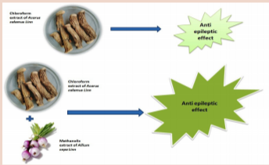

Slide 7
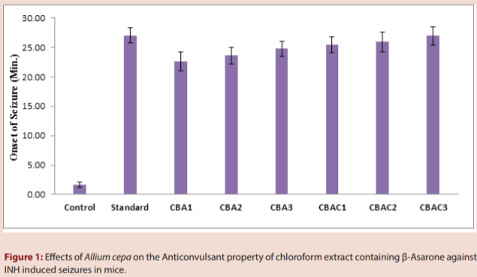

Slide 8
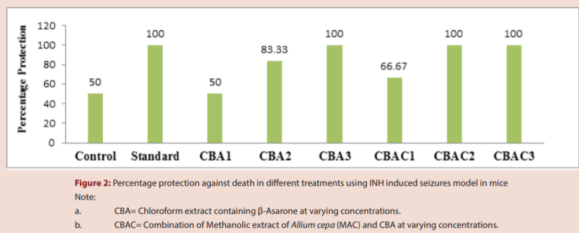

Slide 9
Allium cepa have tremendously ameliorated the antiepileptic potential of chloroform extract containing β-Asarone as major ingredient. This kind of combination therapy not only increases protection but also reduces high degree of toxicities. Also, being naturally occurring ingredients these can be better option for synthetic antiepileptic drugs which are associated with degenerative effects and toxicities.

