Slide 1
In vitro Antidiabetic Activity of Sulforaphane
Shaik Chand Basha, Komaragiri Rajesh Babu, Medabalimi Madhu, Chakka Gopinath

Slide 2
Background: Sulforaphane is mainly found in cruciferous vegetables. It is a glucosidal prodrug with many pharmacological activities like anti oxidant, anti ulcer, anti viral etc. The present work aims the screening of in vitro anti diabetic activity of Sulforaphane from broccoli extract.
Methods: The Hypoglycemic activity was performed with amylase inhibition assay by using chromogenic DNSA method. In this percentage inhibition of analyte was compared with that of control to conclude the proved anti diabetic activity.

Slide 3
Results: Majority analyte concentration of 500μg exhibits significant inhibition of amylase enzyme which reflects potent anti diabetic effect.
Conclusion: Despite of many adverse effects and short shelf life of present drugs here is a proved possibility of anti diabetic effect was found in Sulforaphane from broccoli extract.

Slide 4
KEYWORDS
Antidiabetic activity,
Glucosidal prodrug,
DNSA method.

Slide 5
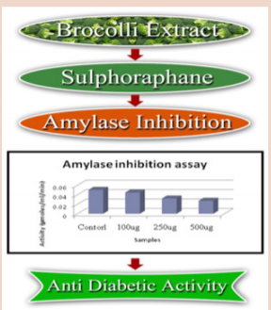

Slide 6
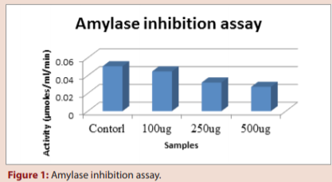

Slide 7
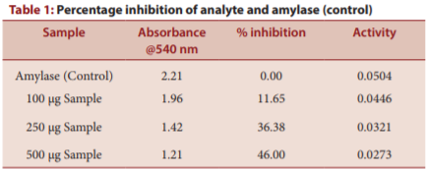

Slide 8
Despite of many adverse effects and short shelf life of present drugs here is a proved possibility of antidiabetic effect was found in sulforaphane from broccoli extract.

