Slide 1
Reliability and Validity of Pharmacy Research Proposal Questionnaire in Saudi Arabia
Yousef Ahmed Alomi, Adel Sadeq

Slide 2
Objectives: To explore reliability and validity of pharmacy research proposal survey in the Kingdom of Saudi Arabia.
Methods: It is a cross-section survey developed by the authors and the researcher team. It’s based on the updated literature, national and international accreditation standards organizations. The internal consistency reliability through, inter-rater reliability, item-item coloration, item-total coloration, split half reliability (Gutmann’s λ6), McDonald’s ω and Cronbach alpha. The validity consisted of face content validity, construct validity through exploratory factorial analysis and confirmatory factor analysis. All analysis had been done through Statistical Package of Social Sciences (SPSS), Statistical Package of Social Sciences-Analysis of Moment Structures (SPSS-Amos) and Jeffrey’s Amazing Statistics Program (JASP).

Slide 3
Results: A total of 209 pharmacists responded. The majority of responders were Saudi 185 (88.52%). The among responders were males 108 (61.77%) and females 101 (48.33%). The three tests had been done of reliability of 17 questions of responders (204). The tests mean±SD was 3.788 ± 0.163, McDonald’s ω, Cronbach alpha and Gutmann’s λ6 were 0.975, 0.975 and 0.987, respectively and inter-item coloration was 0.705. The item-total coloration >0.7, McDonald’s ω, Cronbach alpha and Gutmann’s λ6 value if deleted was >0.97. By using Exploratory Factor Analysis (EFA), the Kaiser-Meyer-Olkin measure of sampling adequacy was 0.954 and Bartlett’s test of sphericity with approximate chi-square was <0.001. The commonalities extraction for all questions was >0.7, the related components were two with the rotated component matrix >0.7 of all 17 questions in components 1 and 2 as suggested. They were confirmed by confirmatory with statistically significant (p<0.001) of the factor model, by factor analysis, by scree plot, pathway analysis and fit with the original survey. The confirmatory factor index was 0.871, Tucker-Lewis Index (TLI) was 0.853, Goodness of fit index (GFI) was 0.912, Expected cross validation index (ECVI) was 4.299. The collinearity of 17 questions was auto-correlation was 0.058 with not statically significant (p=0.403). The majority of 17 questions had Enjuone value had close to number 1, while 7 questions only had condition index less than 30. Most of questions had the Variance inflation factor (VIF) less than 10 except 4 questions, while only 4 questions had tolerance less than 0.1.
Conclusion: The reliability and validity of a survey about knowledge of pharmacy proposals in the Kingdom of Saudi Arabia were high. The pharmacist in pharmacy research practice can utilize the survey in the future.

Slide 4
KEYWORDS
Reliability,
Validity,
Pharmacy,
Research,
Proposal,
Survey,
Saudi Arabia.

Slide 5
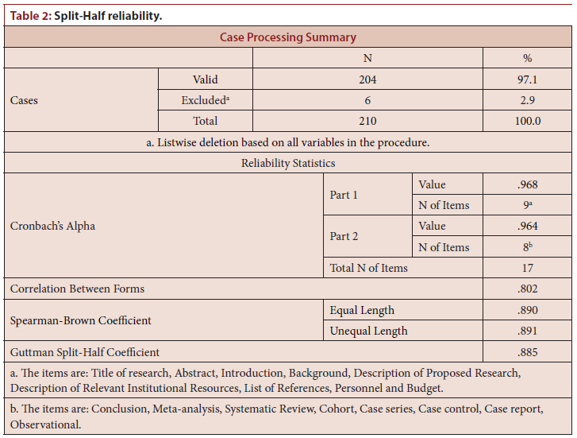

Slide 6
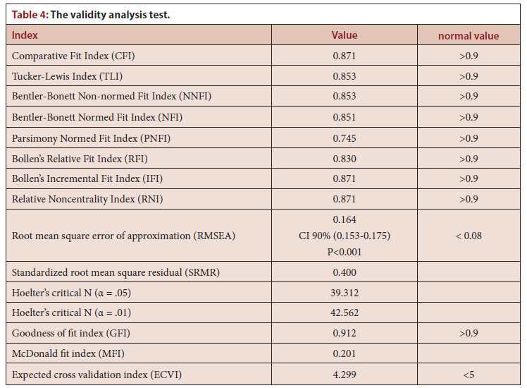

Slide 7
The knowledge about pharmacy research proposal survey distributed in the Kingdom of Saudi Arabia had high reliability and validation scale level. The various test was used for reliability or validity with an emphasis on exploratory factor analysis and confirmatory factor analysis. The survey might be used in the future in Saudi Arabia.

