Slide 1
Dentist’s Knowledge of Evidence-based Dentistry and Digital Applications Resources in Saudi Arabia
Yousef Ahmed Alomi, Anwar Mouslim Alshammari, Hanin Sumaydan Saleam Aljohani

Slide 2
Objectives: Drug information resources provide clinicians with safer use of medications and play a vital role in improving drug safety. Evidence-based medicine (EBM) has become essential to medical practice; however, EBM is still an emerging dentistry concept. Therefore, in this study, we aimed to explore dentists’ knowledge about evidence-based dentistry resources in Saudi Arabia.
Methods: This is a 4-month cross-sectional study conducted to analyze dentists’ knowledge about evidencebased dentistry resources in Saudi Arabia. We included dentists from interns to consultants and those across all dentistry specialties and located in Saudi Arabia. The survey collected demographic information and knowledge of resources on dental drugs. The knowledge of evidence-based dental care and knowledge of dental drug information applications. The survey was validated through the revision of expert reviewers and pilot testing. Moreover, various reliability tests had been done with the study. The data were collected through the Survey Monkey system and analyzed using Statistical Package of Social Sciences (SPSS) and Jeffery’s Amazing Statistics Program (JASP).

Slide 3
Results: A total of 260 dentists responded to the survey. Of them, 51% were interns, 85% as dental staff with three years or less experience by 88.46%. The results showed that most responders (56.76%) did not know that the Evidence-Based Dentistry (EBD) database is a part of the drug information resource. Their institution does not establish it. Almost half of the responders (48.23%) were not familiar with the digital application of dental drug information resources. The average knowledge of dentists regarding EBD drug information resources was 48%. Furthermore, the majority of the resources that the dentists frequently accessed were MEDLINE/PubMed (77.69%), American College of Physicians (www.acponline.org/ clinical information/ guidelines/) (73 (28.08%), and Guideline.gov (www.guideline.gov) (71 (27.31%).
Conclusion: There was inadequate knowledge of evidence-based dentistry of drug information resources in Saudi Arabia. Implementation of these findings is vital for optimizing patient outcomes, improving clinical practice, and patient care.

Slide 4
KEYWORDS
Dentist,
Knowledge,
Evidence-based Dentistry,
Digital Application,
Resources,
Saudi Arabia.

Slide 5
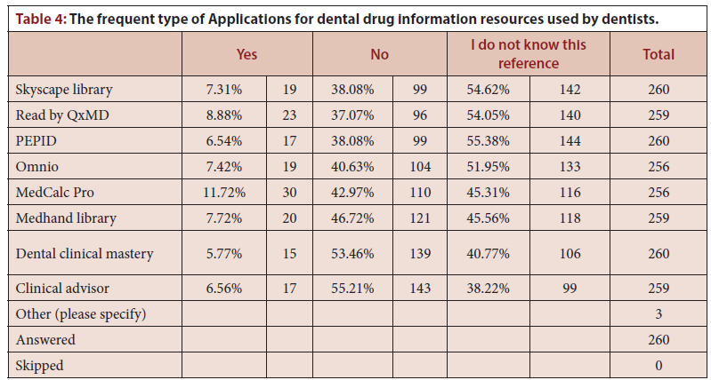

Slide 6
EBD is a new archetype and is not well-known to every dentist; creating awareness regarding EBD is imperative to be highlighted. That can create a unique opportunity for dental staff to strive for excellence of scientific knowledge through evidence finding processes that have a potential role in improving patient healthcare services.

