Slide 1
Analysis of Practice of Drug Information Resources by Dentists in Saudi Arabia
Yousef Ahmed Alomi, Anwar Mouslim Alshammari, Juman saad Mohammad Alsaab

Slide 2
Objectives: This study’s objective was to analyze dentists’ practice of drug information resources in the Kingdom of Saudi Arabia.
Methods: This is a 4-month cross-sectional study about the dentists’ practice of drug information resources in Saudi Arabia. It is a self-reported and electronic survey of dentists. We included dentists from interns to consultants and from all specialties in dentistry and located in Saudi Arabia. The survey consisted of two parts. The first part collected demographic information. The second part collected data about the type of drug information inquiries, aspects of dental drug information resources, and the dental drug information resources and types of dental drug information resources used in practice are responsible. We used the 5-point Likert response scale system to obtain responses to the survey questions. The data were collected through the Survey Monkey system and analyzed through the Statistical Package of Social Sciences (SPSS), Jeffery’s Amazing Statistics Program (JASP), and Microsoft Excel (version 16).

Slide 3
Results: The average number of dental information resources was 0.84 per patient daily. The most commonly referred resource in relation to the dental drug information was biweekly (94 (36.43%)), monthly (92 (35.66%)) followed by weekly (35 (13.58%)) newsletter in addition to those published a few times per year (18 (6.98%)). The most frequently searched question was about the adverse reaction (190 (73.36%)) and drug availability (144 (55.60%)), whereas the majority of the dental prescriptions was related to the oral ulcer (83 (32.05%)) and sedation medications (74 (28.57%)). The average score for the item “implemented items for dental drug information resources” was 1.78. The highest score was obtained for the element “an annual plan of dental drug information resources” (1.88). In contrast, the lowest score was obtained for “dental drug information resources dentist’s competency” (1.7), with statistically significant differences between all responses (p<0.001). The highest scores of dental drug information resources (to authorities) the responsibility was a clinical pharmacist (4.65) and pharmacy technicians (4.34). In contrast, the lowest score was dentists (2.19), with statistical signification among all answers in each aspect (p<0.001).
Conclusion: Despite the demand for resources to resolve drug-related dental care problems, the resources were seldom utilized. Targeting education and training of dental information resources is required to improve dental patient care in Saudi Arabia.

Slide 4
KEYWORDS
??,
??,
??,
??,
??,
??.

Slide 5
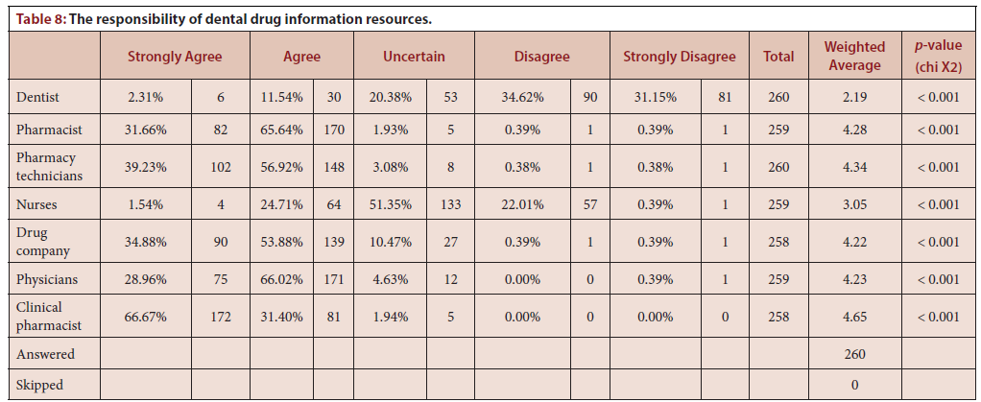

Slide 6
So far, studies conducted on information-seeking behaviors of dental practitioners are scarce. Knowledge of dentists’ information-seeking actions should advance the translational gap between drug information resources and dental practice.

