Slide 1
Public Practice of using Hand Sanitizer and Disinfectant in Saudi Arabia
Yousef Ahmed Alomi, Basmah Sulimain AlHamdan,
Sahar Obaid Alosaimi, Deema Abdullah Altuwayhir

Slide 2
Objectives: Hand sanitizer and disinfectants have become essential because of the ongoing COVID-19 pandemic. Despite the efficacy of sanitizers and disinfectants in preventing disease transmission, the practice of using them has still not improved among the public. Therefore, in this survey, we analyzed the usages of hand sanitizers and disinfectants in the people of the Kingdom of Saudi Arabia.
Designs and Setting: A self-administered, structured questionnaire was sent to the public online, including questions on the responders’ demographics and questions about the type of sanitizer or disinfectant used, the situations, places, and locations where the sanitizer was used during the COVID-19 pandemic. Data were collected through the Survey Monkey system and analyzed via SPSS software.

Slide 3
Results: A total of 402 individuals responded to the questionnaire. Of them, 32.58% of the responders were from the western region, and 25.76% were from the central region, and there were statistically significant differences between all regions (p=0.000). The majority of the responders (90.88%) were Saudi nationals. Small- (3.75) and medium-sized (3.13) sanitizers were the most used. In the case of disinfectants, the highest usage of disinfectants was Dettol (3.97) and Clorox (3.13), with statistically significant differences between the responses (p=0.000). The majority of the times when sanitizers or disinfectants were used during COVID-19 was after going out from the market (4.32), before entering the market (4.19), and during entering the house (4.13), with statistically significant differences between responses (p=0.000). Toilet (214 (54.31%)) and a kitchen (208 (53.06%)) were the sites with the majority of the responses, with statistically significant differences between responses (p<0.001).
Conclusion: Most people in Saudi Arabia use small sanitizers and phenolic and quaternary ammonium salt-containing disinfectants. There was malpractice of the sanitizer or disinfectant. Therefore, we highly recommend increasing the public’s awareness about sanitizer and disinfectants used in Saudi Arabia.

Slide 4
KEYWORDS
Public,
Practice,
Usage,
Utilization,
Sanitizer,
Disinfectants,
Saudi Arabia.

Slide 5
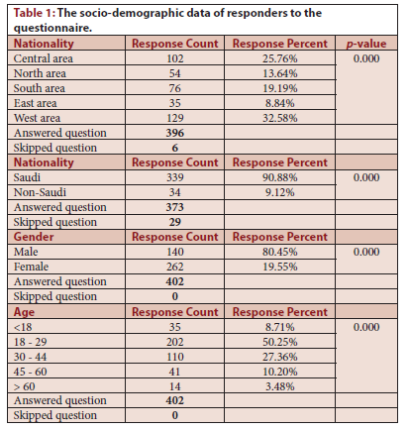

Slide 6
In conclusion, most of the responders used small-sized sanitizers and disinfectants with phenolic and quaternary ammonium salts. The majority of the public used sanitizer or disinfectant after and before market entering situations. Most factors did not affect the use of sanitizer and disinfectants. However, age and members of healthcare professionals are affected more frequently. Therefore, public education about sanitizer and disinfectant utilization is highly recommended to improve appropriate usage and improve the effectiveness of sanitizer and disinfectants. Moreover, we recommend preventing sanitizer and disinfectant-related problems among people in Saudi Arabia.²⁸

