Slide 1
Cost Analysis of Individual Outpatient and Emergency Pharmacy Services in the Kingdom of Saudi Arabia
Mona Yaser Alsheikh, Raghad Abdulaziz Alasmari, Asma Saqer Alamri, Bandar Awwadh Alosaimi, Yousef Ahmed Alomi

Slide 2
Objectives: In this study, we aimed to explore the cost of Individual outpatient and emergency pharmacy services in the Kingdom of Saudi Arabia.
Methods: This is a descriptive analysis crosssectional and questionnaire-based study. We used an electronic survey questionnaire with a judgment sampling system to obtain responses. The structured questionnaire consisted of two parts written in English and Arabic. The first part collected the demographic information of the responders based on multiple-choice questions. The second part contained questions for measuring the personal cost, including the salary cost of a head of ambulatory care or outpatient pharmacist, a clinical pharmacist working at ambulatory care, pharmacist and pharmacy technician, and secretary and porter per hour. The cost was calculated for the preparation time of each medication. The total costs of the place’s overhead cost and cost of equipment used for the outpatient and emergency pharmacy services. Furthermore, the purchased materials and supplies and the non-salary cost were calculated. All costs were used in the US dollar currency. The data were collected through the Survey Monkey system and analyzed using Microsoft Excel version 2020.

Slide 3
Results: The total of judgment responders was six directors of pharmacy. Five were responsible for outpatient pharmacy services, and one was responsible for emergency pharmacy. The majority of the outpatient and emergency pharmacy directors had work experience as pharmacy administrators for more than four years. The total cost of outpatient pharmacy services was 1581.95 USD, whereas the cost of emergency pharmacy services was 729.86 USD. The majority of the cost came from personnel cost from the outpatient pharmacy (1288.15 USD, 81.43%) followed by emergency pharmacy (465.28 USD, 63.75%) and material and supply cost (205 USD, 13.01%) at the outpatient pharmacy and emergency pharmacy services (228.89 USD, 31.36%).
Conclusion: This study conducted the cost analysis of separate outpatient and emergency pharmacy services. Standardized pharmacy administrative and clinical activities are required, and we recommend more additional studies with a large sample size in the Kingdom of Saudi Arabia.

Slide 4
KEYWORDS
Cost,
Separate,
Emergency,
Outpatient,
Pharmacy,
Kingdom of Saudi Arabia.

Slide 5
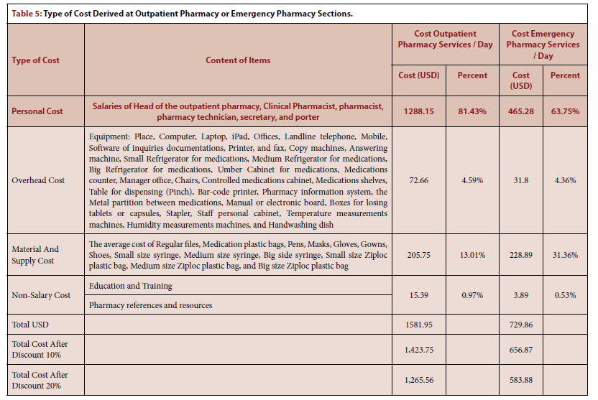

Slide 6
This is the first study conducted on cost analysis of individual outpatient pharmacy and emergency pharmacy services in the KSA. However, further investigation with more hospitals is highly warranted to confirm the cost analysis of outpatient pharmacy and emergency pharmacy in the KSA.

