Slide 1
Cost Analysis of Separate Location of Emergency and Ambulatory Care Pharmacy Services in the Kingdom of Saudi Arabia
Mona Yaser Alsheikh, Bandar Awwadh Alosaimi,
Raghad Abdulaziz Alasmari, Asma Saqer Alamri,
Yousef Ahmed Alomi

Slide 2
Objectives: In this study, we aimed to explore the cost of separated locations of emergency and outpatient pharmacy services in the Kingdom of Saudi Arabia.
Methods: It is a descriptive, crosssectional, and questionnaire-based study. We used an electronic survey with a judgment sampling system to obtain responses. The structured questionnaire consisted of two parts written in English and Arabic languages. The first part collected demographic information of the respondents based on multiple-choice questions. The second part contains questions for measuring the personal cost, the salary of outpatient supervisor, the clinical pharmacist working at outpatient, pharmacist and pharmacy technician, secretary and Porter per hour, in addition to the cost calculation preparation time of each medication, the total prices of the overhead cost for the place, and cost of all equipment used for the emergency services. Furthermore, the cost of purchased materials and supplies plus non-salary cost. Face and content validation had been done through an expert reviewer. In addition, a pilot study was conducted by sending the questionnaire to some hospitals to confirm the validity of the questionnaire and the absence of incomprehensible or misleading questions. Data were collected through the Survey Monkey system and analyzed using Microsoft Excel software version 2020.

Slide 3
Results: The total of judgment responders was 14 directors of pharmacy. Most pharmacy directors experienced emergency pharmacy, outpatient pharmacy, and pharmacy administrators six years and above. OPD pharmacy services’ total cost was (3509.64 USD) while the emergence pharmacy services were (1068.02 USD). The majority of the cost came from personal cost from OPD pharmacy 2542.63 USD (72.45%) vs. emergency pharmacy 826.4 USD (77.36%), and overhead cost 656.01 USD (18.69%) at OPD pharmacy while 144.93 USD (13.57%%) emergency pharmacy.
Conclusion: The cost analysis of nonintegrated outpatient pharmacies and emergency services was high. Therefore, we highly recommend implementing new clinical pharmacy activities or switching to the Saudi managed care pharmacy model in the Kingdom of Saudi Arabia.

Slide 4
KEYWORDS
Cost,
Separated,
Emergency,
Ambulatory care,
Pharmacy,
Kingdom of Saudi Arabia.

Slide 5
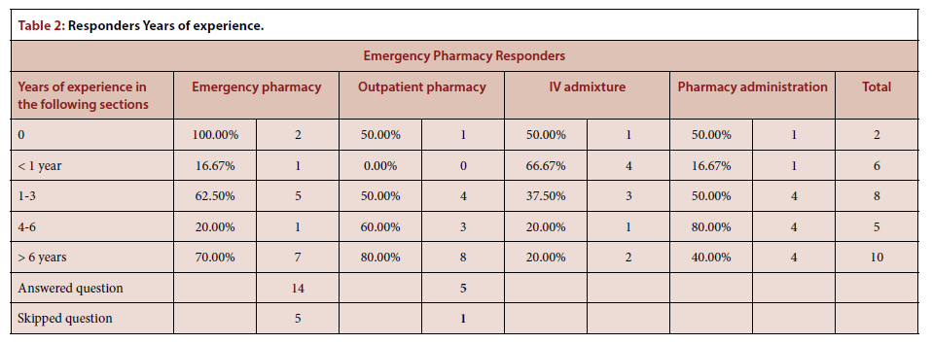

Slide 6
In conclusion, the daily cost of outpatient pharmacy or emergency pharmacy services is high in the KSA. We highly recommend utilizing the resources and implementing the Saudi Managed Care Pharmacy (Wasfaty).33 This implementation might help reduce the economic burden on the pharmacy system in KSA.

