Slide 1
Pharmacy Infection Control: Staff Immunization and Occupational Infections
Yousef Ahmed Alomi, Anhar Alyousef,Mohammed Mominul Islam, Randa Jaroudi, Maha Hussein Almadany, Elaf Mohamaf Faraj, Fatimah Abdaziz Almana

Slide 2
Objectives: This study aimed to declare pharmacy infection control concerning the staff immunization and occupational infections policy as a new initiative in Saudi Arabia.
Methods: This is a narrative review of pharmacy infection control. The literature search was performed using various databases, including PubMed, Medline, and Google Scholar, about specific topics related to infection control in pharmacy practice. The search period was from the 1960s to October 2021. The terms searched were in English and included narrative review, systemic review, meta-analysis, and guidelines. The terms ”Policies” and “Procedures” were limited to the last 10 years across all hospitals, and community pharmacy services were included in the search terms. The committee of pharmacy infection control consisted of various expert members, including clinical pharmacists, community pharmacists, and infection control specialists. The first members drafted the policy. The second members reviewed the draft policy and corrected it. Finally, the third members, an infection control specialist, revised the draft. The topic emphasizes staff immunization policies and procedures and occupational safety for pharmacy infection control.

Slide 3
Results: The staff immunization and occupational safety policy of pharmacy infection control consisted of various items, and it included instructions for adult’s vaccines for pharmacy staff and interns, the adult’s vaccines needed for a particular condition, immunization for occupational infections, and work restriction for infected pharmacy personal. Conclusion: The policies and procedures related to staff immunization and occupational safety are new initiatives in pharmacy practice. It is an active measurement for preventing various infectious diseases among pharmacy personnel. Therefore, staff immunization and safety related to occupational infections policy is the foundation of pharmacy human resources in Saudi Arabia.

Slide 4
KEYWORDS
Pharmacy,
Infection control,
Staff,
Immunization,
Occupational infections,
Occupational
safety,
Saudi Arabia.

Slide 5
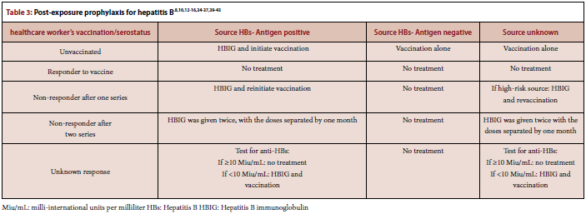

Slide 6
The immunization of pharmacy personnel for vaccine-preventable occupational infections and related occupational protection through the implementation of approved policy and procedures are the fundamental preventive steps at all healthcare establishments. The policy and procedures should be extended to all immunization of new pharmacy employees, including the intern’s vaccinations, immunization for specific conditions, and immunization for any injuries of contaminated sharp materials. To protect themselves, all pharmacy workforce must be familiar with initial employment immunization and occupational infections. Optimal vaccination would enhance the quality of pharmacy workers’ overall performance and avoid any occupational infections.

