Slide 1
Antibiotic Prescribing Pattern; Errors Perspective in Primary Health Care Centers in Riyadh City, Saudi Arabia
Zainab Ibrahim Albahouth, Samia zaben Almurshadi,
Nawaf Marzog Alotibi, Faisal Mushabab Alqhtani,
Ibtisam Nasser Altamimi, Yousef Ahmed Alomi

Slide 2
Objectives: To explore the medication error in prescribing antibiotics in primary health care centers in Riyadh City, Saudi Arabia.
Methods: It is a retrospective analysis of antibiotics prescribing errors of randomly selected twenty-five primary health care centers in Riyadh city. One month’s prescription had been reviewed. The expert pharmacist revised the prescription and documented the errors. The medication error form of MOH had been used to document the errors.

Slide 3
Results: During the study period, 18,031 prescriptions were recorded in all the included study settings. Of the total prescriptions, 3,879 (21.51%) contained antibiotics and were included in the current study. Of the total prescriptions, 1388 (35.78%) prescriptions detected medication errors were analyzed in the current study. The most errors detected in the prescription were height not written 1388 (100%), followed by diagnosis not found 535 (38.54%), and body weight not written 492 (35.45%). The antibiotics errors occurred with pediatrics and adolescents < or = 20 years 673 (50.08%) and adults > 20 years with 671(49.92%) with statically significant differences between all medication error types within pediatrics and adults (p=0.000). The errors identified mainly were related to inappropriate drug selection that occurred in 748 (53.9%) of the prescriptions, followed by low therapeutic dose 277 (20.0%) and dose frequency 175 (12.6%), with statistically significant differences between all types (p=0.000). The most Medications with errors were Amoxicillin 576 (41.5%), Amoxicillin/clavulanate 277 (28.1%), Fucidic Acid 123 (8.9%), and Azithromycin 116 (8.4%).

Slide 4
Conclusion: One-third of primary healthcare centers prescriptions contained antibiotics and had at least one error. The most errors related to demographic information and most prescribed antibiotics at primary healthcare centers. Targeting electronic prescribing systems and implementing stewardship antimicrobial programs at primary healthcare centers are highly suggested.

Slide 5
KEYWORDS
Medication error,
Prescribing,
Antibiotics,
Primary health care center,
Riyadh,
Saudi Arabia.

Slide 6
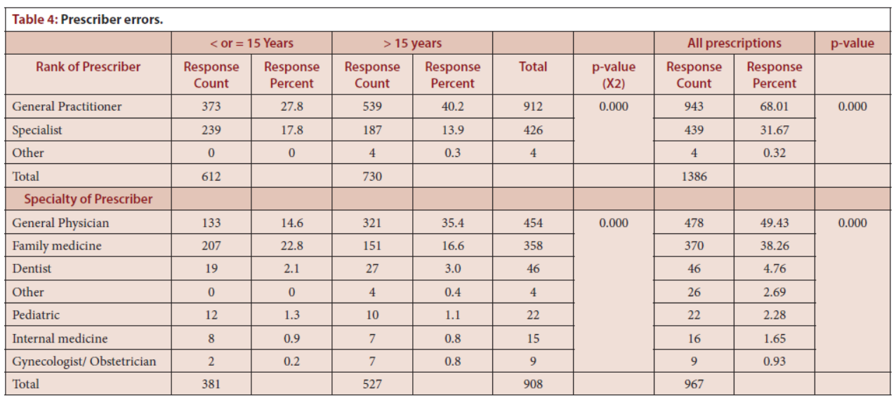

Slide 7
This study demonstrated a high prevalence of medication errors related to antibiotics. Improving how we prescribe and use antibiotics is critically effective in treating common infections and protecting patients from adverse drug reactions. The antibiotic errors revealed the absence of antimicrobial stewardship programs at primary healthcare centers. The antibiotics prescribing errors might lead to over or underuse antibiotic use and might lead to antibiotic resistance. Targeting to implement antibiotic guidelines emphasizing education and training is highly recommended.

