Slide 1
Pharmacy Technician Job Satisfaction with Communication and Relationships Factors in Saudi Arabia
Yousef Ahmed Alomi, Faiz A. Bahadig Rph,
Reem Saad Alsubaie, Bayan Ibrahim Alghuraybi,
Budoor Emad Aloumi

Slide 2
Purpose: To explore the Pharmacy technician job satisfaction with Communication and relationships factors in Saudi Arabia.
Methods: It is a 4-months cross-section survey of the stress factors impacting pharmacy technician job satisfaction in Saudi Arabia. The study consisted of 35 questions divided into two-part demographic information and the second part consisted of three parts. Part one was about stress-related factors of pharmacy job. Part two included the questions about pharmacy services units of pharmacy job. Part three questions about communication and relationships factors of pharmacy technician job. In addition, overall job satisfaction. The questionnaire made as an electronic format and it was analyzed through survey monkey system about part three communication and relationships factors of pharmacy technician job.

Slide 3
Results: The total responders were 96. The gender distribution 83 (86.46%) was male and 13 (13.54%) was female. The majority of them 86 (89.58 %) were in age group (20-39) years. The average satisfaction score of pharmacy supervisors’ factors was (3.175), pharmacy technician interaction with other healthcare providers’ factors was (3.38). While the customer interaction was (3.45) the pharmacy technician relationship with coworkers was (3.85). Most of the pharmacy technician found the challenges at their job were (79.2%). Some responders wished to change their pharmacy career (60%) previously while (78%) liked to stay in the pharmacy field. The overall job satisfaction scores were (3.62).
Conclusion: Most of the pharmacy technicians were not satisfied with their job because the supervisor was not supportive and as they faced challenges in their work. Management tool to all pharmacy staff including the supervisors and pharmacy technician in the culture work is highly recommended at healthcare institutions in the Kingdom of Saudi Arabia.

Slide 4
KEYWORDS
Pharmacy technician,
Job satisfaction,
Communication,
Relationships,
Factors,
Saudi Arabia.

Slide 5
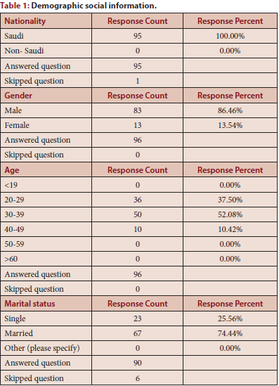

Slide 6
Our results suggest that policies governing the pharmacy technician profession need to be talked with more apprehension as the level of job satisfaction, is relatively low-slung and may generate monetary and work force problems in Saudi Arabia. Pharmacy technician’s job satisfaction has not reached to the optimal level. The pharmacy technicians had communication challenges with supervisor and healthcare professionals. More than half wished to change the Pharmacy field. Targeting of an annual survey of pharmacy technician’s job satisfaction related to communication factors is required in Saudi Arabia.

