Slide 1
Cost-effectiveness Analysis of Medication Safety Program at Pediatrics, Obstetrics and Gynecology Hospital, East Province, Saudi Arabia
Yousef Ahmed Alomi, Amal Ahmad Alanazi, Mohammed Mohsen Almaznai, Fatimah Ali Albusalih

Slide 2
Objectives: Medication safety program initiated at East Province of Ministry of Health in 2013. The pharmacist prevents all drug related problems. To improve continuity of care at hospital admission, discharge and to diminution medication errors medication safety programs are established. The objective of this study was to evaluate the cost-effectiveness of the Medication Safety program at the hospital in East province, Saudi Arabia by using International Study Model.
Methods: This cross-sectional study with a 12-month recruitment period was conducted in a 500-bed Pediatrics, Obstetrics and Gynecology Hospital through preventing and documentation of medication errors in adults and pediatrics at Ministry of Health hospitals in 2015. The hospital had medication safety officer with medication safety committee. The program led by trained pharmacist and delivered basic patient safety in medical education to all healthcare professionals. The expected cost calculated using International Study Model, expressed in United State Dollars (USD), the cost measured were the expected results of medication errors outcome if not stopped; starting from ambulatory care visit or community pharmacy, additional laboratory test, hospital or critical care admission or even death complications.

Slide 3
Results: The total number of prevented medication errors were 2071 at 827 prescribed to 827 patients with an estimated cost avoidance of avoiding medication was (116,228.41 USD) annually. The most estimated cost avoidance was prescriber related and general errors was 99.12% (115.201.9 USD). The pharmacist avoided medication errors with estimated cost avoidance of drug related problem (140.54 USD) per each prescription and (56.12 USD) per error. The most common categories of medications cost avoidance were Musculoskeletal and joint disease (8,397.2 USD) followed by Infections (5,731.17 USD) and Nutrition class (4,717.99 USD). The highest drug of cost avoidance were Insulin injection (39,964.32 USD), iron tablet (11,526.9 USD) folic acid tablet (11,526.9 USD) and calcium tablet (11,526.9 USD) and Enoxaparin injection (9,637.02 USD). There were three high-risk medication founded with Insulin, Enoxaparin and Heparin errors with (42.9%) of annual total cost avoidance.
Conclusion: Medication safety program is a cost-efficiency replication at Pediatrics, Obstetrics and Gynecology Hospital in Saudi Arabia, prevents medication misadventures, improve patient safety and education. Growing drug safety program related with preventing drug-related problems and cost avoidance replication for Healthcare improvement, better care and better patient consequences.

Slide 4
KEYWORDS
Cost,
Efficiency,
Medication,
Safety,
Ministry of Health,
Pediatrics,
Obstetrics and Gynecology,
Saudi Arabia.

Slide 5
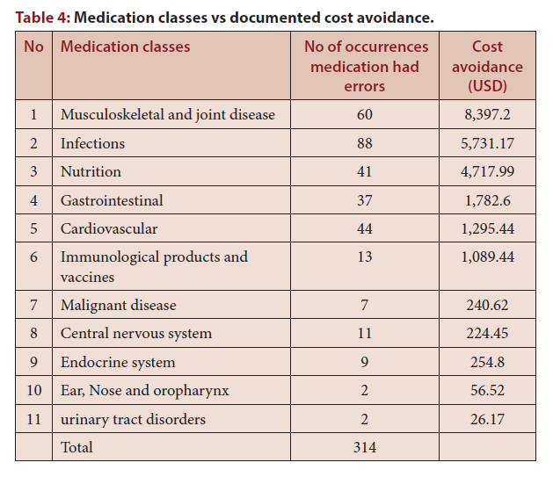

Slide 6
Medication safety program is a cost-efficiency replication at Pediatrics and Obstetrics and Gynecology Hospital in Saudi Arabia, prevents medication misadventures, improve patient safety. Increasing drug safety program associated with preventing drug-related problems and cost avoidance replication for Healthcare improvement, better care and better patient consequences. High-quality economic evaluations with healthy methodologies and study design are required to explore what pharmacist services have noteworthy clinical benefits to patients and verify the greatest cost savings for healthcare budgets.

