Slide 1
The Economic Outcomes of Pharmacist Interventions at Critical Care Services of Private Hospital in Riyadh City, Saudi Arabia
Yousef Ahmed Alomi, Manal El-Bahnasawi, Alaa Elemam, Tasneem Shaweesh, Edmarie Janine Antonio

Slide 2
Objectives: The study aims to explore the economic outcomes of the clinical pharmacist at critical care units at a private hospital in Riyadh city, Saudi Arabia in a 6 month study and prevent additional medication costs.
Methods: It was a 6-months cross-sectional study from January to June 2016 in adults critical care unit. It was a thirty-bed critical care bed consisting of trauma, medical, surgical and maternity critical care cases. The pharmacist monitored all patients through daily medical round and documents any pharmacist intervention. The pharmacist intervention system used an international study model, measure level of activity, rational of clinical intervention, recommendation, patient outcome and pharmacoeconomic impact related estimated cost avoidance.

Slide 3
Results: The total number of pharmacist interventions were (1,222) provided to (1,124) patients. The complete cost avoidance from pharmacist intervention over the study period was (220,882.10 UD) while over one year was (441,764.2 USD). The highest cost avoidance of critical care interventions was from potentially significant 51.00% (102,581.78 USD) and potentially serious 32.28% (99,162.29 USD). The majority of cost avoidance came from anti-infective agents (73,408.95 USD) followed by nutrition and blood agents (61,182.97 USD) and cardiovascular medications (27,584.52 USD). The most rational clinical activities cost avoidance was from others type (102,168.44 USD) followed by inappropriate dose (30,504.16 USD) and TPN consultations (25,313.99 USD). The most patient outcome related to cost avoidance was patient condition improved (120,036.38 USD) followed by unknown outcomes (47,067.85 USD) and laboratory values improved (21,661.55 USD). The most pharmacoeconomic cost avoidance impact was a reduction in the cost drug therapy 79.94% (163,747.96 USD) and the patient length of hospital stay decreased 1.15% (32,846.49 USD).
Conclusion: The critical care clinical pharmacist prevent the additional cost of drugrelated problems occurrences and economic burden on the healthcare system at a private hospital in the Kingdom of Saudi Arabia. Expanding clinical pharmacist at critical care services is highly recommended to all private hospitals in Saudi Arabia.

Slide 4
KEYWORDS
Economic outcomes,
Pharmacist,
Interventions,
Critical care services,
Private hopsital,
Riyadh,
Saudi Arabia.

Slide 5
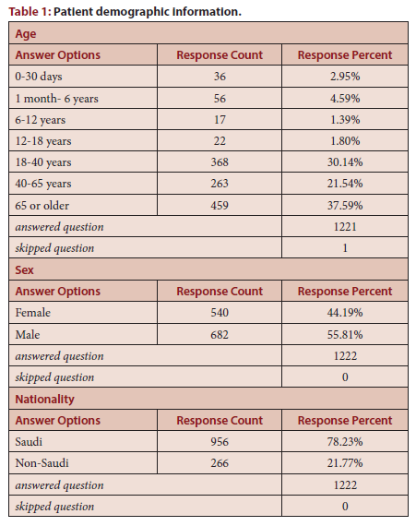

Slide 6
The pharmacist plays a significant role at critical care services of the private hospital. The pharmacist condition improved, decrease drug therapy cost and patient length hospital stay. Expanding critical care pharmacist at a private hospital is highly recommended and appreciated in the Kingdom of Saudi Arabia.

