Slide 1
Improving Access to New Treatments with Value Based Pricing: An Indian Perspective
Amit Dang, Shilpa Mendon, Pruthvi Desireddy

Slide 2
The last few years have witnessed significant changes in pharmaceutical pricing model across the world. These changes were driven primarily by payers in an attempt to control rising health care costs. As per the old concept of pharmaceutical pricing model, prices were determined by market forces with hardly any scrutiny by regulatory bodies. These old methods have given way to some of the newer concept such as the Value Based Pricing (VBP), Health Technology Assessment (HTA) and Health Outcomes Analysis (HOA). VBP is an innovative method of pricing medicines wherein both the payers and pharma companies agree to link payment for a medicine to value achieved i.e. actual observed in real-world performance.

Slide 3
Pricing is based on willingness to pay or the perceived additional benefit of new drugs relative to established comparator therapies. Value based pricing results in improved patient outcomes and ensures consistent access to medicines. As a result, elements of VBP are commonly embraced in mature pharmaceutical markets viz. Australia, Belgium, Canada, Denmark, France, Germany, Italy, Japan, the Netherlands, Norway, South Korea, Spain, Sweden and the United Kingdom (beginning autumn 2014). However, regulators in India are lagging behind other countries in adopting elements of VBP in their pricing model. This review will discuss various aspects of VBP including its impact on health care system and patients; barriers to the use of VBP; and reasons for its absence in India.

Slide 4
KEYWORDS
Treatment Access,
Value Based Pricing,
Health Technology Assessment,
Health Outcomes,
Pharmaceutical Pricing.

Slide 5
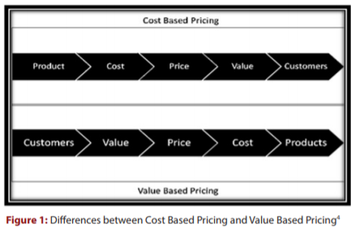

Slide 6
In several mature markets, VBP is being increasingly adopted by payers as a way to focus their limited pharmaceutical budgets on drugs that meet genuine clinical needs and better reward manufacturers for developing such medicines. Though it might be a tough time for pharmaceutical industry to get over the challenges of VBP and value based innovation, it definitely would lead to access of basic healthcare to the bottom of the pyramid community.10 Today value-based health care movement is a growing collection of people, organizations and governments that strongly believe value-of-care should replace volume-of-care. This quest for value in health care is now a global trend and can result in unprecedented impact. It is time that regulator in India become a part of this trend and bring about the necessary change in the healthcare sector for implementing value-based pricing as a core strategy. Adopting the following principles can enable alignment of all healthcare components:17

Slide 7
Shifting the focus from just lowering cost to value for patients; value that is, driven by provider experience, scale and learning at the medical condition level.
Enabling free flow of information on results and prices that is essential for value-based competition.
Encouraging innovation in healthcare by strongly rewarding any increase in value to the patient or society.

