Slide 1
Informed Consent Template by Strategic Initiative for Developing Capacity in Ethical Review. A Good Alternate?
Krishnan Vengadaragava Chary

Slide 2
Obtaining informed consent from (ICF) the participants of a clinical trial, bioavailability and bioequivalence studies, and investigator initiated research consists of two documents; participants’ information sheet and informed consent form. Informed consent is also a mandate for epidemiological and observational studies. It ensure participants autonomy to enroll them in trials and also legally valid for their post trial access and compensation. As a dictum, it should be in English and vernacular language signed by study subjects or their legally accepted representative (LAR). There are valid differences in opinion about amount of information that should be in given consent form.

Slide 3
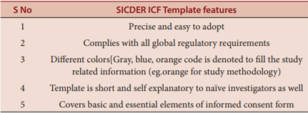
Highlights of SIDCER form

