Slide 1
National Survey of Medication Safety Practice: Patient Information at Primary Healthcare Centers/Community Pharmacies in Riyadh, Saudi Arabia
Yousef Ahmed Alomi, Rana Mohammed Alslim, Manar Mohammed Alslim, Khulud Abdulrahman Alamoudi, Zainab Abdulmunem Almuallem, Adel Mehmas H. Alragas

Slide 2
Objective: To explore patient’s information regarding national medication safety Practice At Primary Healthcare Centers (PHCs) and Community Pharmacies (CPs) in Riyadh city, Kingdom of Saudi Arabia.
Methods: This is a 4-month cross-sectional survey conducted on medication safety practice at PHCs and CPs in Riyadh city. In this study, the survey was adapted and modified from the Institution of Safe Medication Practice (ISMP) medication safety self-assessment for community/ambulatory pharmacy. It consists of a demographic section and 10 domains with 198 questions. The domains captured the following information: patient information; drug information; communication of drug orders and other drug information; drug labeling, packaging and nomenclature; use of medical devices; environmental factors; staff competency and education; patient education; quality processes; and risk management domain. The survey was conducted at the PHCs of the Ministry of Health and at CPs located in Riyadh city. This study is focused on the first domain, that is, patient information in PHCs and CPs in Riyadh city.

Slide 3
Results: The survey was distributed to 13 PHCs and 23 CPs. The average ± Standard Deviation (SD) of all ISMP-self assessment items of medication safety practice at PHCs was 2.75±0.36 (54.94%) (95% confidence interval (95% CI) = 2.55–2.95; P<0.05; range = 2.04–3.38). The average ± SD score of all ISMP-self assessment items of medication safety practice at CPs was 3.14±0.42 (62.86%) (95% CI = 2.90–4.38; P<0.05; range = 2.40–.88). The average ± SD score of patient information at PHCs was 2.80±0.467 (56%) (95% CI = 2.54–3.58; P<0.05; range = 2.08–3.45), whereas that of the CPs was 2.60±0.667 (52 %) (95% CI = 2.23–2.97; P<0.05; range = 1.36–3.96).
Conclusion: The PHCs and PCs implemented almost half the of ISMP medication safety critical elements including the patient information related issue. Targeting to improve medication safety system at PHCs and CPs is highly recommended in the Kingdom of Saudi Arabia.

Slide 4
KEYWORDS
Medication,
Safety,
Patient,
Information,
Primary Healthcare Center,
Community Pharmacy,
Riyadh,
Saudi Arabia.

Slide 5
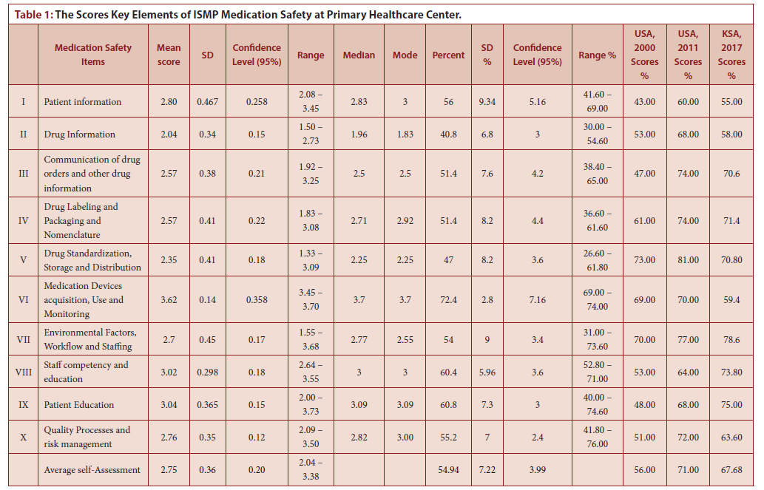

Slide 6
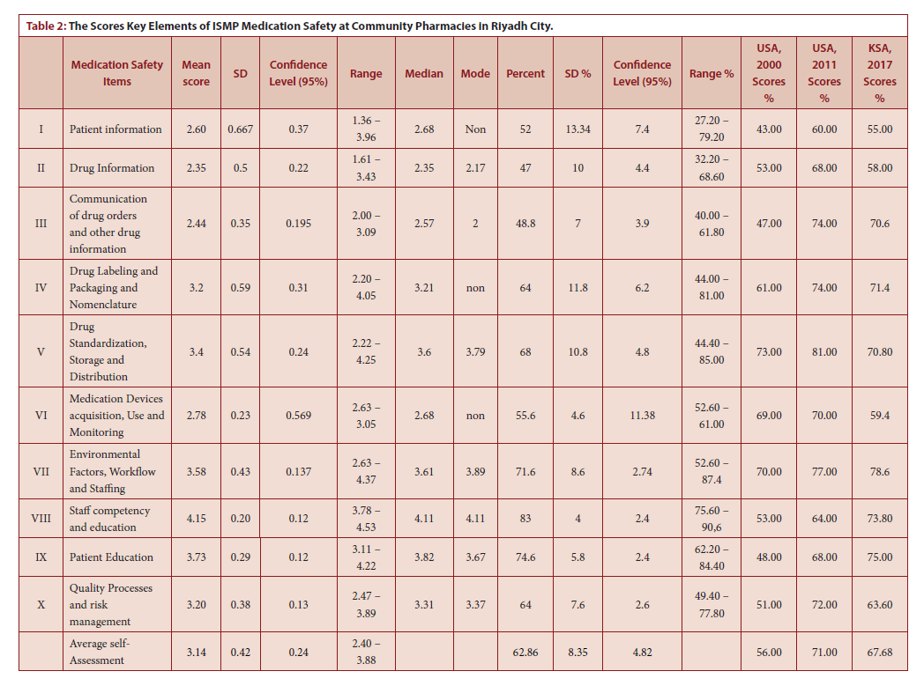

Slide 7
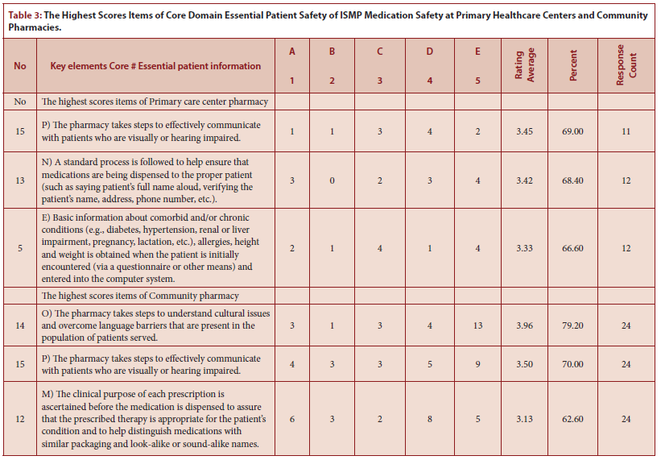

Slide 8
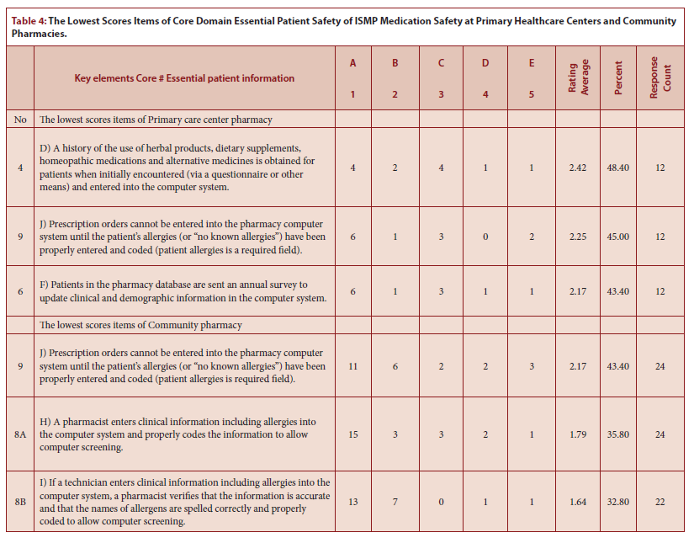

Slide 9
The ISMP self-assessment of medication safety at PHCs and CPs in the KSA is first done in the Middle East and the rest of the world. Only half of the medication safety key elements implemented at PHCs and CPs. Approximately half of the patient information related to safety is missed in PHCs and CPs. The new technology and Saudi Managed Care Pharmacy maybe improve the patient information associated safety. Further studies with a high number of PHCs and CPs is required. Besides, Annual or biannually self-assessment of medication safety at PHCs and CPs is highly recommended in the Kingdom of Saudi Arabia.

