Slide 1
Effect of Ganoderma lucidum, Spirulina and Vitamin D on Diazepam-Induced Anterograde Amnesia in Male Wistar Rats: An Experimental Study
Savithasree S, AP Hogade

Slide 2
Objective: Current study was to check the effect of Ganoderma lucidum, Spirulina, and vitamin D on Diazepam-induced anterograde amnesia in male Wistar rats.
Methods: Six groups (I–VI; n = 10) of healthy male Wistar rats (150–180 g) were used for the study. The induction of anterograde amnesia was done by diazepam. The Morris water maze was used to study the amnesia where the rats must swim to hidden escape platform. The rats were trained to locate a hidden escape platform by releasing them into water for four times a day for four consecutive days. The acquisition of this task was measured by noting the time taken to escape the platform. On day 5 of the study, retrieval of this learnt task was measured by noting the time taken to search for the missing hidden escape platform. These two test times were then compared with the test groups and drug-induced amnesia groups. The time was expressed as mean ± standard error of mean.

Slide 3
Results: Ganoderma lucidum and Spirulina completely ameliorated the induction of anterograde amnesia by diazepam. The escape latency time of vitamin D-administered rats was less when that of diazepam-administered rats but was not statistically significant.
Conclusion: Ganoderma lucidum, Spirulina and vitamin D ameliorated the oxidative stress-induced anterograde amnesia pointing toward a possible antioxidant role of them. These, at the commonly prescribed clinical doses, can therefore potentially inhibit oxidative stress-induced neurodegeneration, especially in the ageing population. Further studies are needed to substantiate these findings.

Slide 4
KEYWORDS
Anterograde amnesia,
Ganoderma lucidum,
Spirulina,
Vitamin D,
Morris water maze.

Slide 5
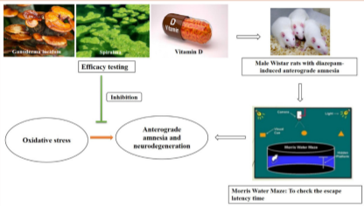

Slide 6
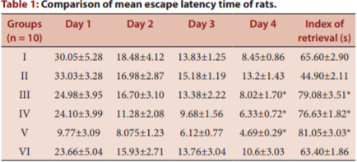

Slide 7
Study finding suggests that the Ganoderma lucidum and Spirulina has a definite role in ameliorating anterograde amnesia induced by diazepam, and vitamin D also has a partial response after administration.

