Slide 1
National Survey of Clinical Pharmacy Practice in Saudi Arabia-2017-2018: Administration and Management
Yousef Ahmed Alomi, Fatimah Al-Doughan,
Sultan Mohammed Al-Jarallah, Yasir Ahmed Ibrahim,
Adel Mehmas Alragas, Norah Omar Bin Haidarah

Slide 2
Objectives: In this study, we explored the national survey of clinical pharmacy practice in Saudi Arabia during 2017-2018 with an emphasis on the administration and management of pharmacy practice.
Methods: This is a 4-month cross-sectional national survey of clinical pharmacy practice in Saudi Arabia. The survey consisted of two parts: the demographic information and the second part comprised a questionnaire with 51 questions divided into four domains. The domains were derived from the standards and guidelines provided by the American Society of Health-System Pharmacists (ASHP), Saudi Pharmaceutical Society (SPS), the international standard of Joint Commission of Hospital Accreditation, in addition to the local standards of Saudi Center of Healthcare Accreditation. The four domains were the clinical pharmacy administration and management, performances and activities, education and training and workload documentation. We used 5-point Likert response scale system with closeand open-ended questions to obtain the responses. The questionnaire was distributed in an electronic format to the 31 directors of pharmacies at hospitals. In this study, we conducted a national survey of clinical pharmacy practice at hospitals in Saudi Arabia on performances and activities. All data were obtained through the Survey Monkey system.

Slide 3
Results: The survey questionnaire was distributed to 31 hospitals. The average score of the elements related to the clinical pharmacy administration was 3.32 (66.31%). Most of the elements responded were policies and procedures of pharmacist privilege (4.00 (80.00%)) followed by the mission of clinical pharmacy (3.87 (77.40%)) and vision of clinical pharmacy administration (3.71 (74.20%)). Most of the clinical pharmacy services provided for adult, pediatric, neonate and geriatric patients was for critical care, medical services and for emergency. Most of the hospitals had no satellite services assistant the clinical pharmacy services (22 (70.97%)). The majority of the responders agreed that clinical pharmacy services improve the safety and effectiveness of patient care (27 (93.10%)), decreases morbidity and mortality rate (23 (79.31%)) and increases the pharmacist’s role toward patient care (20 (68.97%)).
Conclusion: The elements of clinical pharmacy administration were not adequate in the KSA. Most of the hospital services received the clinical pharmacy services not exceeding 50%. Despite the fact that the pharmacy administration has a good record of clinical pharmacy services, there are not enough resources to provide over 24-hr service. Revision of clinical pharmacy services is highly necessary in Saudi Arabia.

Slide 4
KEYWORDS
Clinical,
Pharmacy,
Practice,
Administration,
Management,
Saudi Arabia.

Slide 5
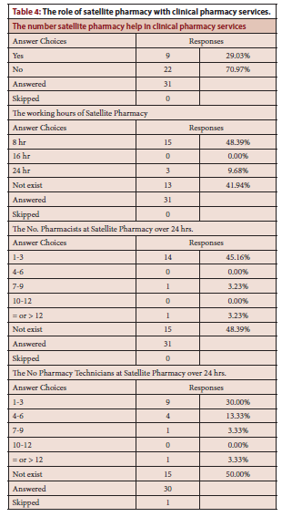

Slide 6
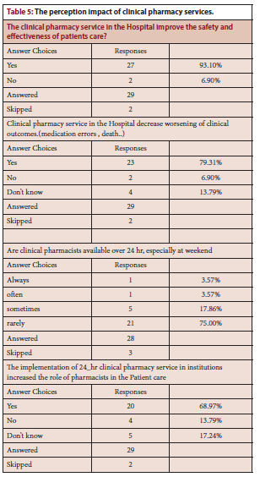

Slide 7
Clinical pharmacy services are very crucial elements in the KSA. The administration elements of clinical pharmacy services for instance strategic plan, annual plan, clinical pharmacist job satisfaction, clinical pharmacist competency, pharmacy technician competency and clinical pharmacy quality have not been fully implemented at hospitals. All clinical pharmacy services should be revised and further studies about clinical pharmacy services are highly suggested in the KSA.

