Slide 1
Reliability and Validity of EBM Resources of Pharmacy Research Questionnaire in Saudi Arabia
Yousef Ahmed Alomi, Ebtissam Mohammad Badawoud

Slide 2
Objectives: To declare reliability and validity of EBM Resources Knowledge used for Pharmacy Research Survey in Saudi Arabia.
Methods: It is a cross-section survey developed by the authors and the researcher team. It’s based on the updated literature, national and international accreditation standards organizations. The internal consistency reliability through, inter-rater reliability, item-item coloration, item-total coloration, split half reliability (Gutmann’s λ6) and McDonald’s ω, Cronbach alpha. The validity contained of face content validity, construct validity through exploratory factorial analysis and confirmatory factor analysis. All analysis had been done through Statistical Package of Social Sciences (SPSS), Statistical Package of Social Sciences-Analysis of Moment Structures (SPSS-Amos) and Jeffrey’s Amazing Statistics Program (JASP).

Slide 3
Results: A total of 209 pharmacists responded. The majority of responders were Saudi 185 (88.52%). The responders were males 108 (61.77%) and females 101 (48.33%). The three tests had been done with reliability of 16 questions. The completed number of responders (200) (mean ± SD) was 3.179 ± 0.436, McDonald’s ω, Cronbach alpha and Gutmann’s λ6 were 0.967, 0.966 and 0.976, respectively, inter-item coloration was 0.719, the item-total coloration >0.7, McDonald’s ω, Cronbach alpha and Gutmann’s λ6 value if deleted was >0.97. By using Exploratory Factor Analysis (EFA), the Kaiser-Meyer-Olkin Measure of sampling adequacy was 0.941 and Bartlett’s test of sphericity with approximate chi-square was <0.001. The commonalities extraction for all questions were >0.58, the related components were one of the rotated component matrix >0.59 of all 16 questions in component 1 as suggested. They were established by confirmatory with statistically significant (p<0.001) of the factor model, by factor analysis, by scree plot, pathway analysis and fit with the original survey. The confirmatory factor index was 0.862, Tucker-Lewis Index (TLI) was 0.841, Goodness of fit index (GFI) was 0.906 and Expected cross validation index (ECVI) was 3.270. The collinearity of 16 questions was the auto-correlation was 0.066 with not statically significant (p=0.317). The majority of 16 questions had Enjuone value close to number 1, while 3 questions only had condition index more than 30. All of the 16 questions had The Variance inflation factor (VIF) less than 10 and had tolerance more than 0.1.
Conclusion: The pharmacist survey knowledge of evidence-based medicine resources for pharmacy practice and distributed the Kingdom of Saudi Arabia had high reliability and validity scale level. The pharmacy researcher can utilized surveys with an adequate number of sample sizes with further research in Saudi Arabia.

Slide 4
KEYWORDS
Reliability,
Validity,
EBM,
Resources,
Knowledge,
Pharmacy,
Research,
Saudi Arabia.

Slide 5
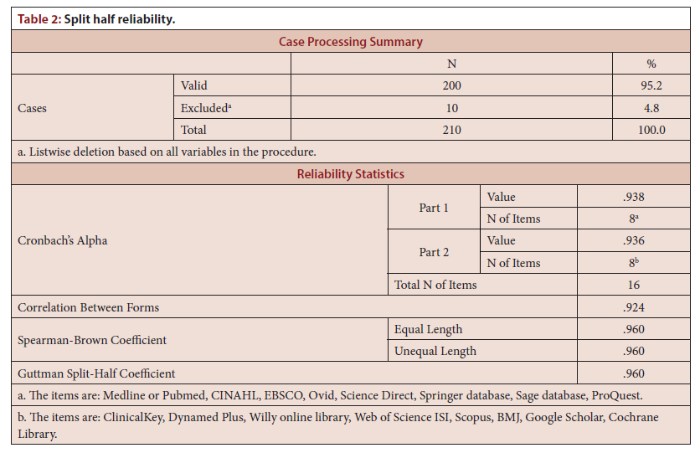

Slide 6
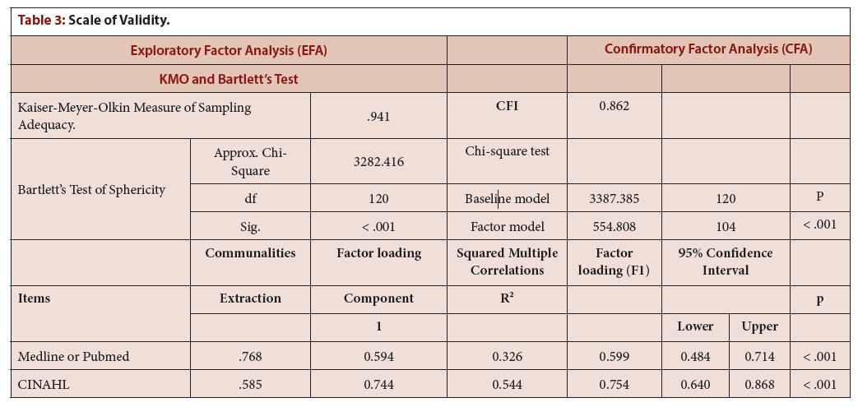

Slide 7
The clinical and administrative privilege of a pharmacist in Saudi Arabia was not optimum in practice. Majority of the clinical and administrative privileges of a pharmacist were found to be basic and common practice duties. Therefore, it is highly recommended to establish clinical and administrative privileges for pharmacists in order to improve patient care and implement the quality management standers as part of the accreditation process of healthcare organizations. The implementation of pharmacist privilege of clinical and administrative pharmacy is highly required in the KSA.

