Slide 1
Reliability and Validity of Pharmacy Research Knowledge Questionnaire in Saudi Arabia
Yousef Ahmed Alomi,
Adel Sadeq

Slide 2
Objectives: To declare reliability and validity of pharmacy research knowledge survey in Saudi Arabia.
Methods: It is a cross-section survey developed by the authors and the researcher team. It’s based on the updated literature and national and international accreditation standards organizations. The internal consistency reliability through, inter-rater reliability, item-item coloration, item-total coloration, split half reliability (Guttmann's λ6), McDonald’s ω and Cranach alpha. The validity contained of face content validity, construct validity through exploratory factorial analysis and confirmatory factor analysis. All analysis had been done through Statistical Package of Social Sciences (SPSS), Statistical Package of Social Sciences-Analysis of Moment Structures (SPSS-Amos) and Jeffrey’s Amazing Statistics Program (JASP).

Slide 3
Results: A total of 209 pharmacists responded. The majority of responders were Saudi 185 (88.52%). The among responders were males 108 (61.77%) and females 101 (48.33%). The three tests had been done with reliability of 21 questions. The completed number of responders (188) (mean±SD) was 3.179 ± 0.436 and McDonald’s ω, Cranach alpha and Guttmann's λ6 were 0.983, 0.983 and 0.988, respectively with CI 95% (0.979-0.986) and the item-total coloration >0.7, McDonald’s ω, Cranach alpha and Guttmann's λ6 value if deleted was >0.98. By using Exploratory Factor Analysis (EFA), the Kaiser-Meyer-Olkin measure of sampling adequacy was (0.966) and Bartlett’s test of sphericity with approximate chi-square was <0.001. The commonalities extraction for all questions were >0.583, the related components were one with the rotated component matrix >0.763 of all 21 questions in component 1 as suggested. They were established by confirmatory with statistically significant (p<0.001) of the factor model, by factor analysis, by scree plot, pathway analysis and fit with the original survey. The confirmatory factor index was 0.878, Tucker-Lewis Index (TLI) was 0.865, Goodness of fit index (GFI) was 0.862 and Expected cross validation index (ECVI) 5.101. The collinearity of 21 questions was the auto-correlation was 0.010 with not statically significant (p=0.816). The majority of 21 question had Enjuone value had close to number 1, while 12 questions only had condition index more than 30. All 16 of the questions had the Variance inflation factor (VIF) less than 10 and had tolerance more than 0.1.
Conclusion: The reliability and validity of the pharmacy research knowledge survey in the Kingdom of Saudi Arabia were high. The researcher can use it in the future with the same goal and acceptable sample size.

Slide 4
KEYWORDS
Reliability,
Validity,
Pharmacy,
Research,
Knowledge,
Survey,
Saudi Arabia.

Slide 5
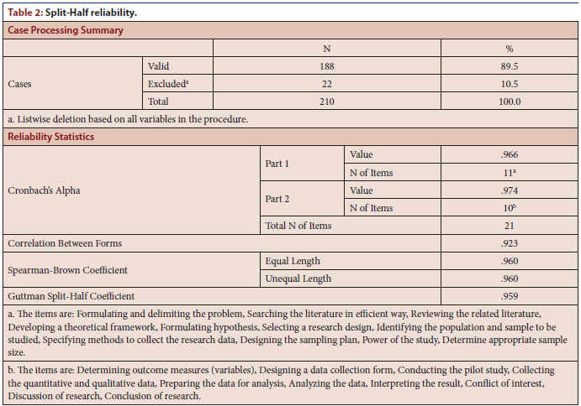

Slide 6
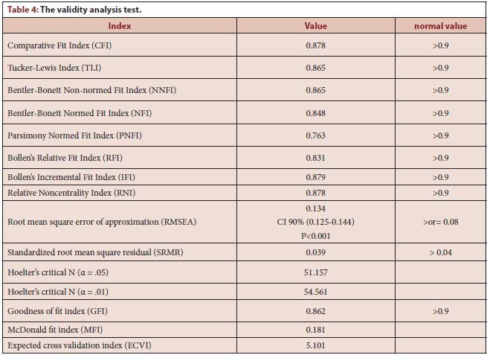

Slide 7
The pharmacy research knowledge survey in Saudi Arabia had high reliability with internal consistency through various biostatistical tests. Besides, the validation of the survey was high through the factorial analysis method. The researcher can use the survey with the same goal and enough sample size.

