Slide 1
Dentist’s Experiences and Expectations of Pharmacists in Saudi Arabia
Yousef Alomi, Abdulaziz Al-Humaidan,
Abdullah Alazzam

Slide 2
Objectives: To declare the dentist’s experiences and expectations of pharmacists in the kingdom of Saudi Arabia.
Methods: It is a 4-month cross-sectional study about dentist’s experiences and expectations of pharmacists in Saudi Arabia. It self-administered validated electronic survey with closed-ended questions, and the 5-point Likert response scale system was used. The survey consisted of demographic data of responders and items about dentists’ perception of pharmacists’ actual experiences, pharmacists’ recent experiences, future expectations of pharmacists, and barriers hiding the pharmacist role in the practice.

Slide 3
Results: The total number of dentist’s responders were 398 dentists. Of those, 205(51.51%) were male, and 193 (48.49%) were female. Most participants were 229(57.54%) general practitioners and 75(18.61%) residents. Many dentists contacted pharmacist for drug availability inquiries 311(79,13%) and drug-drug interactions questions 265(68.65%). The average scores of dentist’s actual experiences of pharmacists were (3.12), the average scores of dentist’s current expectations of pharmacists were (3.6), and dentist’s future expectations of pharmacists were (3.52).
Conclusion: Dentist experience and expectations of pharmacists were inadequate in the kingdom of Saudi Arabia. Targeting pharmacists’ awareness of pharmacists in the dental care and collaboration programs and activities or therapeutic guidelines between dentists and pharmacists are required.

Slide 4
KEYWORDS
Dentist,
Experiences,
Expectations,
Perception,
Pharmacists,
Saudi Arabia.

Slide 5
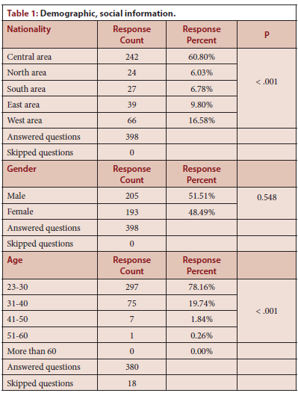

Slide 6
Most dentists contacted pharmacists for drug availability and adverse drug reaction inquiries, although One-third of dentists is never getting a pharmacist. Dentist experience of pharmacists was inadequate with adequate perception of pharmacists as drug information resources. The dentists’ expectations were not positive with pharmacists’ high respect to provide medications education for their patients. In the future, the dentist expects the pharmacist to be involved in dental drug therapy and responsible for patient outcomes and choose the appropriate and costeffective medications during dental practice in Saudi Arabia.

