Slide 1
Dentist’s Knowledge of Essential Drug Information Resources in Saudi Arabia
Yousef Ahmed Alomi, Anwar Mouslim Alshammari, Hanin Sumaydan Saleam Aljohani

Slide 2
Objectives: To explore the knowledge of dentists regarding drug information resources in Saudi Arabia.
Methods: This is a 4-month cross-sectional study exploring the knowledge of dentists about drug information resources in Saudi Arabia. This is a self-reported electronic survey of dentists. The questionnaire contained two parts. The first section collected demographic data of the responders. In contrast, the second section collected information about dentists’ essential knowledge about dental drug information resources, knowledge of the selected 12 dental drug information books, and their preferred 17 websites containing dental drug information resources. We used 5-point Likert response scale system to obtain responses to the close-ended questions. The data were collected through the Survey Monkey system and were analyzed using SPSS and Jeffery’s Amazing Statistics Program (JASP).

Slide 3
Results: A total of 260 dentists responded to the survey. Of them, 153 (59.30%) were male, and 105 (40.7%) were female, which was statistically significant (p<0.003). The majority of the responders (257 (98.85%)) were in 24–35 years. Almost half of the responders were interns (135 (51.92%)) followed by residents (63 (24.23%)) and as General Practitioner with (62 (23.85%)), which was statistically significant (p<0.001). The average score of dentist knowledge about dental drug information resources was 1.80, and the highest score was recorded for knowledge of the concept of dental drug information resources. The average dental knowledge score of dental drug information resources was 1.80, which was statistically significant (p<0.5). The majority of the responders (80.70%) were not familiar with dental drug information books. In contrast, the best resources known by the responders were Martindale: The Complete Drug Reference (55 (21.24%)) and ADA Dental Drug Handbook (54 (20.77%)). The majority of the responders (74.30%) were not familiar with the websites related to dental drug information resources. In comparison, the most frequently used resources by the responders were the World Health Organization (WHO) (137 (52.69%)) and Ministry of Health websites (137 (52.69%)).
Conclusion: The responders had insufficient knowledge about the available dental drug information resources, including books and websites. Targeting to improve dentist knowledge of dental drug information resources is required in Saudi Arabia through dental schools, and pharmacists play a critical role in dental education.

Slide 4
KEYWORDS
Dentist,
Knowledge,
Drug Information,
Resources,
Saudi Arabia.

Slide 5
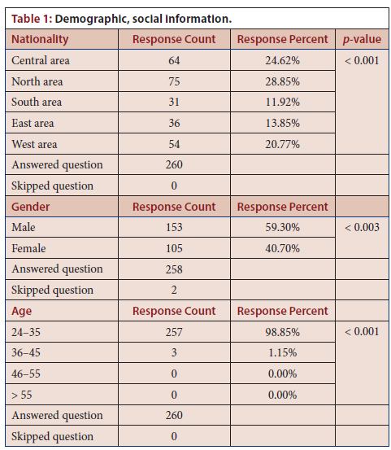

Slide 6
In this study, we explored dentists’ current knowledge about dental information resources in the Kingdom of Saudi Arabia. This study showed that dentists’ knowledge regarding dental drug information resources was inadequate, including knowledge about various books and internet resources. Therefore, we recommend increasing steps in educating and training dentists across the Kingdom of Saudi Arabia. Pharmacists play an essential role in the training provided on dental drug information resources.

