Slide 1
Perception of Dentists about Drug Information Resources in Saudi Arabia
Yousef Ahmed Alomi, Anwar Mouslim Alshammari, Khaznah Saad Alshammari

Slide 2
Objectives: Previous studies have shown that overprescription of antibiotics and other drugs is still existing in dentistry. Fortunately, dental drug information resources can be used to help dentists choose the proper medication. In this study, we aimed to study dentists’ perceptions of dentists concerning the use of dental drug information resources in Saudi Arabia.
Methods: This is a 4-month descriptive cross-sectional study. This self-reported electronic survey included dentists from all specialties of dentistry in Saudi Arabia. All nondentists and students were excluded from this study. The survey collected demographic information, dentists’ perceptions about dental drug information resources, and the barriers preventing them from implementing dental drug information resources. The survey was distributed through social media, and the data were validated and revised by expert reviewers and pilot testing. The reliability was assessed based on Cronbach’s alpha value. The data were collected through the Survey Monkey system and analyzed using SPSS and JASP software.

Slide 3
Results: A total of 260 dentists responded to this survey, with 28.85% responding from the north and 24.62% responding from the central region. Of them, 59.30% were male, and 40.7% were female responders. The majority of the dentists (98.85%) were in 24–35 years. Almost 51.92% of the dentists were interns, followed by residents (24.23%) and general practitioners (23.85%). The score of dentists’ perceptions of dental drug information resources was (3.6); the highest for the element “acknowledging that drug information resources can prevent medication errors and lead to positive outcomes.” The lowest score was recorded for the aspect (2.33) “dental drug information resources are new for the dentist,” and they change the dentist’s initial prescribing habits. The average score for the perception of barriers to implementing dental drug information resources was (3.5); the pharmacists were not aware of their responsibility, and dental drug information resources were not appropriately taught in dental school.
Conclusion: Dentists need to be encouraged to learn about drugs. Dental schools should implement medication-focused courses to help students better understand the drug information resources. Further studies are warranted to measure the knowledge of undergraduate students of dentistry regarding the practice of dental drug information resources.

Slide 4
KEYWORDS
??,
??,
??,
??,
??,
??.

Slide 5
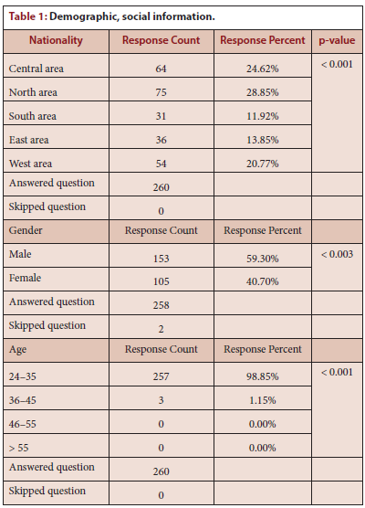

Slide 6
The use of drug information resources by dentists can make it easier for them to prescribe. Dentists need to be encouraged to gain more knowledge and perception to a good perception about dental drugs information resources. Implementation of medication-focused courses in dental schools can be a huge step in understanding drug information resources better. More studies are needed to measure the perception of undergraduate dentists regarding medications periodically.

