Slide 1
Perception and Attitude of Public about Hand Sanitizers and Disinfectants in Saudi Arabia
Yousef Ahmed Alomi, Basmah Sulimain AlHamdan,
Sahar Obaid Alosaimi, Deema Abdullah Altuwayhir,
Aseel Hamed Alzaidi

Slide 2
Objectives: The public had malpractice and attitudes toward hand sanitizer and disinfectants during epidemic and pandemic situations. Even though there is evidence that sanitizers and disinfectants are efficacious and prevent disease transmission, the public’s perception and attitude about their efficacy are still controversial. Therefore, in this study, we aimed to investigate the perception and attitude of hand sanitizers and disinfectants in the Kingdom of Saudi Arabia.
Design and Setting: A self-administered, structured questionnaire was sent to the public via online mode. The survey collected demographic information and information about perception and attitude about using hand sanitizer or disinfectant during COVID-19. Data were analyzed with the SPSS program.

Slide 3
Results: A total of 402 participants responded to the questionnaire. Of them, 32.58% were from the western region, and 25.76% were from the central region, with statistically significant differences between different regions (p=0.000). Most of the responders (90.88%) were Saudi nationals. In addition, the majority of the responders (65.17%) were females, with statistically significant differences between males and females (p=0.000). The average score for attitude was 2.65. The average score for the perception was obtained for the element “dedicate a specific place in the house to store hand sanitizer or disinfectant” (3.90). The responders accepted the sanitizer of disinfectant information from the health practitioners (3.75). The average score of perception was 3.18. The part with most perception by the patient was “the efficacy and safety of sanitizer and disinfectant is the best factor to get them” (4.01), and “there is a big difference between sanitizer and disinfectant in effectiveness and safety” (3.75).
Conclusion: The public’s perception of sanitizers and disinfectants was inadequate in the Kingdom of Saudi Arabia. The public had the perception of knowledge of sanitizers and disinfectants, appropriate storage conditions, non-usage of herbal medications, and use of sanitizers and disinfectants. However, they had a wrong perception of the benefits of sanitizer and disinfectant-related problems. Therefore, public awareness about sanitizer and disinfectants should be improved in the Kingdom of Saudi Arabia.

Slide 4
KEYWORDS
Public,
Perception,
Sanitizer,
Disinfectants,
Saudi Arabia.

Slide 5
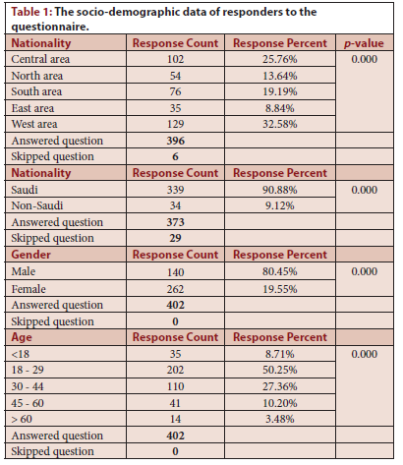

Slide 6
In conclusion, the level of perception of the public about sanitizer and disinfectants was insufficient in the Kingdom of Saudi Arabia. The public obtained appropriate scientific information about sanitizers and disinfectants from healthcare professionals. They agreed with the proper storage of sanitizer and disinfectant. On the contrary, the perception of the benefits of sanitizer and disinfectant and contraindications related to their use was insufficient. The majority of the factors did not affect the perception of the public about sanitizers and disinfectants. However, age plays an essential role in a positive change of perception. Therefore, a comprehensive campaign of education and training to the public about sanitizer and disinfectants is highly recommended³¹ to improve the perception, knowledge, and utilization of sanitizers and disinfectants.

