Slide 1
The Practice of Scientific Publications by Pharmacists in Saudi Arabia
Yousef Ahmed Alomi, Sultan Mohammed Al-Jarallah,
Juman Saad Mohammad Alsaab, Razan Alshehri,
Khawla Ibrahim Al-shahrani

Slide 2
Objectives: In this study, we aimed to assess the practice of scientific publications by pharmacists in the Kingdom of Saudi Arabia.
Methods: In this cross-sectional survey study, we aimed to assess the practice of scientific publications by pharmacists in Saudi Arabia. We used a self-reported electronic survey questionnaire and distributed it to pharmacists from interns to consultants and specialists in Saudi Arabia. The survey collected demographic information and information about the type of publications made by them, the selected elements used during scientific publications, and the social media platforms where they distribute your publication. We used a 5-point Likert response scale system with close-ended questions to obtain responses. The data were collected through the Survey Monkey system and analyzed using the Statistical Package of Social Sciences (SPSS), Jeffery’s Amazing Statistics Program (JASP), and Microsoft Excel software (version 16).

Slide 3
Results: A total of 543 pharmacists responded to the questionnaire. Of them, more than one-quarter were from the central region (5 (28.55%)) followed by the eastern region (133 (24.49%)), with statistically significant differences between regions (p=0.000). Females responded (321 (59.12%)) more than males (222 (40.88%)). Based on nationality, Saudi nationals (351 (64.64%)) responded more than non-Saudi nationals (192 (35.36%)), with statistically significant differences between them (p=0.000). The average score for type of journal for scientific publications was 3.99 with high scores obtained “article in the international scientific journal” (4.26) and “article in the local scientific journal” (4.22), with statistically significant difference between responses (p=0.000). The average score of pharmacist practice of unique elements during scientific publications was 3.81, with high scores obtained for the element “are your colleague’s reviewers” (4.10) and “spelling and grammar checker through special software” (3.95). The average score for the “type of social media platforms to distribute your scientific publications” was 3.33, with high scores obtained for WhatsApp (3.73) and YouTube (3.56). The scores for the single-test reliability analysis of McDonald’s ω was 0.939, Cronbach’s α was 0.935, Gutmann’s λ2 was 0.942, Gutmann’s λ6 was 0.976, and greater lower bound was 0.990.

Slide 4
Conclusion: The practice of scientific publication by pharmacists was found to be fair in Saudi Arabia. An annual report about pharmacists involved in the scientific publication is suggested. We recommend improving the practice of scientific publications by pharmacists in Saudi Arabia.

Slide 5
KEYWORDS
Practice,
Scientific,
Publications,
Pharmacist,
Saudi Arabia.

Slide 6
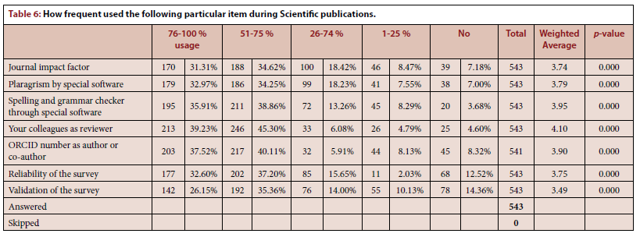

Slide 7
The practice of publishing scientific research was found to be acceptable in the Kingdom of Saudi Arabia. However, some factors negatively affected the practice, such as the old age of pharmacists, the high level of work experience, and higher position. However, some factors did not affect the practice of publishing articles, such as geographic location, gender, and practice area. Therefore, key performance indicators of scientific publications are suggested to improve the outcome of publication in scientific research in Saudi Arabia.

