Slide 1
Voluntary/Charitable Pharmacy Practice in Saudi Arabia
Yousef Ahmed Alomi, Maha Hussein Almadany,
Abeer Hussin Almasoudi, Ghudair Tashan Alanazi,
Khawla Ibrahim Al-Shahrani

Slide 2
Objectives: To demonstrate the pharmacist practice of the voluntary or charitable pharmacy in Saudi Arabia.
Methods: It analyzes a cross-sectional survey that discussed the Pharmacist practice of voluntary or charitable pharmacies in Saudi Arabia. The survey consisted of respondents’ demographic information about pharmacists and Pharmacy charity general practice, the practice of voluntary or charitable in various sectors. The 5-point Likert response scale system was used with closedended questions. The survey was validated through the revision of expert reviewers and pilot testing. Besides, various tests of reliability, McDonald’s ω, Cronbach alpha, Gutmann’s λ2, and Gutmann’s λ6, had been done with the study. The data analysis of the Pharmacist practice of charity pharmacies is done through the survey monkey system. Besides, the Statistical Package of Social Sciences (SPSS), Jeffery’s Amazing Statistics Program (JASP), and Microsoft Excel sheet version 16.

Slide 3
Results: A total number of 578 pharmacists responded to the questionnaire. Of them, one-third responded from the Central region (180 (31.14%)), and one Quarter responded from the western region (140 (24.22%)), with statistically significant differences between the provinces (p=0.000). Males responded more than females (373 (64.53%)) versus 205 (35.47%)), with statistically significant differences among gender (p=0.001). Most of the responders were in the age group of 35-44 years (155 (26.82%)), age group 25-34 years (144 (24.91%)), age group 45-54 years (126 (21.80%)), and with statistically significant differences between all age groups (p=0.000). Less than one-half of the responders, Always, 251 (43.65%), or sometimes 130 (22.61%), participated as pharmacy volunteers before, with a statistically significant difference between the responses (p<0.000). Most pharmacists participate in pharmacy volunteer More than once a week, 260 (45.45%), or 129 (22.55%) a few times a year. Most of the responders participated in pharmacy charity for getting paradise 338 (59.61%), Improved their CV 283 (49.91%), and met their attractive 232 (49.91%). The majority of pharmacists prefer to participate as pharmacy volunteers during Disaster period 400 (70.03%), Ramadan time 368 (64.11%), regular days 363 (63.24%), and Hajj period 322 (56.10%).

Slide 4
Conclusion: The charitable pharmacy practice by pharmacy practitioners was inadequate. The majority of pharmacy providers spend little time annually practicing charitable pharmacy activities and prefer to participate during disasters, the holy month of Ramadan, and the Hajj period. Therefore, awareness of charitable pharmacy practice is essential to improve pharmacy participation in the future.

Slide 5
KEYWORDS
Voluntary,
Charitable,
Charity,
Pharmacy Practice,
Pharmacist,
Saudi Arabia.

Slide 6
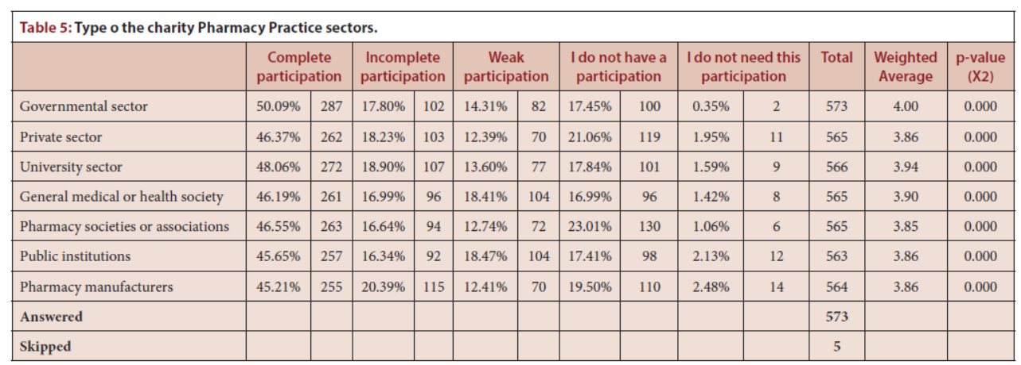

Slide 7
The charitable pharmacy practice in Saudi Arabia was insufficient. Almost one-half of the responders did not participate in philanthropic activities. Those who participated spent little time in a week or a year. The pharmacy profession is involved in getting paradise and improving their Curriculum vitae. Most share during disasters, Ramadan, and Hajj and prefer participating in government pharmacy sectors. Various factors might affect participation. Such female pharmacists participate more than males, middle age pharmacists are more shared, and new graduates are more involved in charitable activities. Companion awareness programs about charitable activities in pharmacy practice are highly recommended to improve pharmacy professions in charitable activities and non-profit work in Saudi Arabia.

