Slide 1
Perceptions and Attitudes about the Voluntary/Charitable Pharmaceutical Care Services in Saudi Arabia
Yousef Ahmed Alomi, Abeer Hussin Almasoudi, Maha Hussein Almadany, Ghudair Tashan Alanazi, Khawla Ibrahim Al-shahrani

Slide 2
Objectives: To illustrate the pharmacist perception of voluntary or charitable pharmacies in Saudi Arabia.
Materials and Methods: It analyzes a cross-sectional survey that discussed Pharmacist perception of voluntary or charitable pharmacies in Saudi Arabia. The survey consisted of respondents’ demographic information about pharmacists, The Perception of voluntary or charitable pharmacies, and barriers, which factors may Discourage you from implementing voluntary or charitable pharmacy. The 5-point Likert response scale system was used with closed-ended questions. The survey was validated through the revision of expert reviewers and pilot testing. Besides, various tests of reliability, McDonald’s ω, Cronbach alpha, Gutmann’s λ2, and Gutmann’s λ6 been done with the study. The data analysis of the pharmacist knowledge of charity pharmacies is done through the survey monkey system. Besides, the statistical package of social sciences (SPSS), Jeffery’s Amazing Statistics Program (JASP), and Microsoft Excel sheet version 16.

Slide 3
Results: A total number of 578 pharmacists responded to the questionnaire. Of them, one-third responded from the Central region (180 (31.14%)), and one Quarter responded from the western region (140 (24.22%)), with statistically significant differences between the provinces (p=0.000). Males responded more than females (373 (64.53%)) versus 205 (35.47%)), with statistically significant differences among gender (p=0.001). Most of the responders were in the age group of 35-44 years (155 (26.82%)), age group 25-34 years (144 (24.91%)), age group 45-54 years (126 (21.80%)), and with statistically significant differences between all age groups (p=0.000). The average score of perception of pharmacists about the Charity pharmacy was (3.69). The element “I am willing to implementation of the charity pharmacy” obtained the highest score (3.90). The aspect “I am getting the clinical outcome for the patient from charity pharmacy” (3.78). The average score of perception of pharmacists about factors that may (Discourage) you from participating in the charity pharmacy was (3.46). The element “the charity pharmacy Should not be mandatory” obtained the highest score (3.57). The aspect “There is not periodic training of medical staff about charity pharmacy” (3.52).

Slide 4
KEYWORDS
Perceptions,
Attitudes,
Voluntary,
Charitable,
Pharmaceutical Care,
Services,
Saudi Arabia.

Slide 5
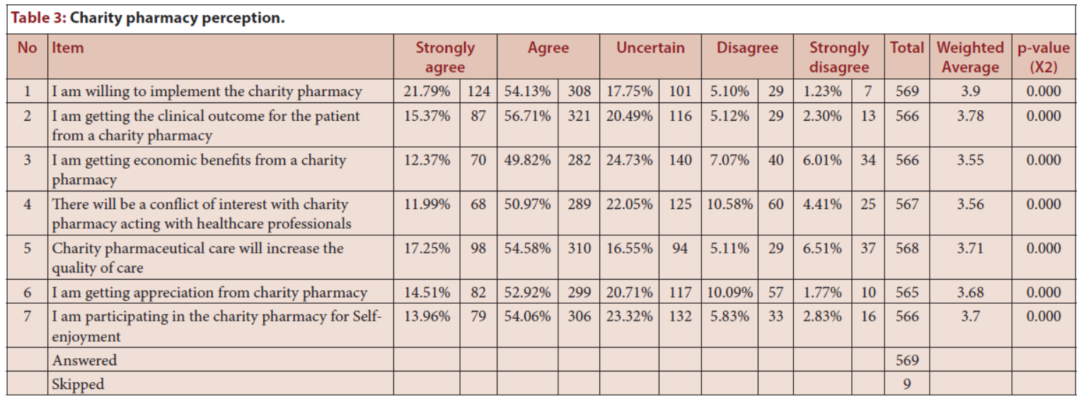

Slide 6
The perception of pharmacy professionals about charitable pharmaceutical care services and factors discouraging participation was sufficient. The study was first done locally and in Arabic countries with an appropriate calculated sample size and high-reliability results. Thy pharmacy provider highly agreed to implement charitable pharmacy activities and get clinical outcome benefits for patient care. Pharmacy professionals are not interested in getting economic benefits from charitable pharmacy services; they wish to provide excellent services to poor people. The pharmacy professional wish to do charitable work in pharmacy practice as mandated for all pharmacy staff. The most significant barrier to implementing charitable activities was a lack of education and training in undergraduate and undergraduate pharmacy fields. Various factors might negatively and positively affect charitable pharmaceutical care services, such as young graduates of a pharmacist, with limited experience. Besides, previous knowledge and practice of charitable pharmacy services. The charitable pharmacy practice should be supported by the college of pharmacy and pharmacy associations to improve charitable activities in the pharmacy community in Saudi Arabia.

