Slide 1
Communication and Relationships Factors of Pharmacy Career Satisfaction in Saudi Arabia
Yousef Ahmed Alomi, Faiz A. Bahadig,
Saima Qaism, Khurram Shahzad, Budoor Emad Aloumi,
Bayan Ibrahim Alghuraybi, Reem Saad Alsubaie

Slide 2
Objectives: This article describes the overall job satisfaction of pharmacists working in Saudi Arabia by exploring their communication and relationship with supervisors and patients. The aim of this study to declare the communications and relationship factors of Pharmacist Job satisfaction in Saudi Arabia.
Methods: This is a 4-months cross section survey of communication and relationship factors on Pharmacist Job satisfaction in Saudi Arabia. The study consisted of forty-three questions divided into two-part demographic information and the second part was the questions about communication and relationships factors of pharmacy job. It included pharmacy supervisors, relationship with coworkers and pharmacist interaction with other healthcare providers, the customer interaction and overall job satisfaction.

Slide 3
Results: The total responders were two hundred and forty-two. The gender distribution 169 (70.7%) was male and 70 (29.3%) was female. The majority of them 202 (84.2%) were in age (20-39). The average satisfaction score of pharmacy supervisors’ factors was (3.0), pharmacist interaction with other healthcare providers’ factors was (3.34) while the customer interaction was (2.81) and the pharmacist relationship with coworkers was (3.67). Most of the pharmacist found the challenges at their job were (77.6%). Some responders wished to change their pharmacy career (43.75%) while (61.66%) liked to stay in the pharmacy field. The overall job satisfaction scores were (3.61).
Conclusion: Most of the pharmacists not satisfied with their job because of the supervisor relationship and non-existent patient education services. The pharmacy supervisors of hospital pharmacies demanded management tools and communication skills with their colleagues. In addition, patient counselling program should be implemented at healthcare institutions in Saudi Arabia.

Slide 4
KEYWORDS
Communication,
Relationships,
Factors,
Pharmacy,
Career,
Satisfaction,
Saudi Arabia.

Slide 5
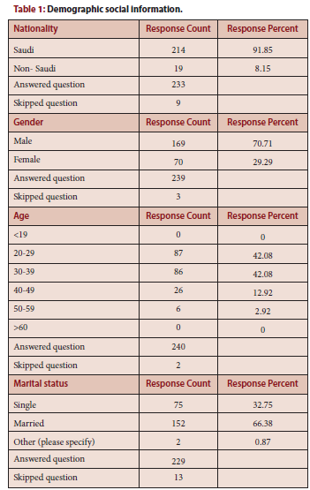

Slide 6
The pharmacist job satisfaction was inadequate. The supervisors did not support the pharmacist. The pharmacist had challenges in the pharmacy work with inadequate customer communication. Annual survey of Pharmacist job satisfaction with an emphasis on communication factors is highly recommended in the Kingdom of Saudi Arabia.

