Slide 1
Stress Factors Impact on Pharmacist Job Satisfaction in Saudi Arabia
Yousef Ahmed Alomi, Faiz A. Bahadig Rph,
Khurram Shahzad, Saima Qaism, Budoor Emad Aloumi,
Bayan Ibrahim Alghuraybi, Reem Saad Alsubaie

Slide 2
Purpose: To explore the stress factors impact of pharmacist job satisfaction in Saudi Arabia.
Methods: It is a 4-months cross section survey of the stress factors impact of pharmacist job satisfaction in Saudi Arabia. The study consisted of 44 questions divided into two-part demographic information and the second part was the questions about stress related factors of pharmacy job. It included pharmacy management policies, pharmacy stress factors, pharmacy personal time, salary and benefits, pharmacy motivation factors, overall job satisfaction. The 5-points Likert response scale system closed ended questions were used.

Slide 3
Results: The total responders were 242. Of those 214 (91.8 %) was Saudi and 33 (8.2%) was non-Saudi. The gender distribution 169 (70.7%) 55.8%) was male and 70 (29.3%) was female. The average pharmacist satisfaction score of pharmacy management policies factors was (3.53), personal pharmacy time was (3.14) and salary and benefits were (2.45) as explored in Table 4. The average score of pharmacy stress factors were (3.86) and the overall job satisfaction was (3.61) as explored in Table 5. The most pharmacy motivation factors found were the financial reward and salary advancement was 201 (87.01%), followed by the time needed for education and training was 144 (62.3%) and flexibility in work scheduling was 136 (58.87%) as explored in Table 6.
Conclusion: The majority of pharmacists suffered from pharmacy salary and benefits and time demand for development and education. Those factors were essential of motivation factors related to the pharmacy job satisfaction in Saudi Arabia.

Slide 4
KEYWORDS
Stress,
Factors,
Job,
Satisfaction,
Pharmacy,
Saudi Arabia.

Slide 5
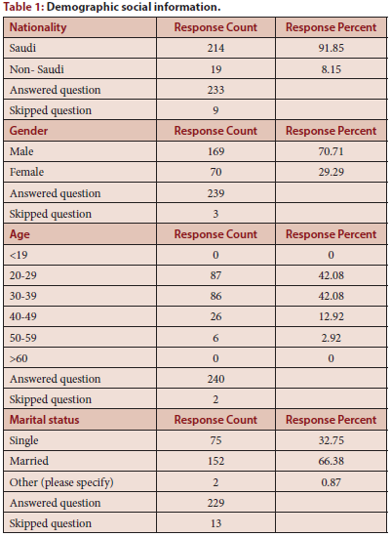

Slide 6
The most stress factors was affected on pharmacist job satisfaction was salary, benefits and shortage of pharmacy time for medical education. Targeting to start motivation elements included salary flexible schedule for medical education will raise pharmacist job satisfaction in the kingdom of Saudi Arabia.

